Slide 1
[PART-B] Unit 7&8 DEMAND SIDE MANAGEMENT (DSM)
Prepared by
Prof. S.D.Hirekodi
Assistant Professor
Dept of EEE
HIT-Nidasoshi

Slide 2
Syllabus- unit 7 & 8
DEMAND SIDE MANAGEMENT (DSM)
Introduction to DSM, concept of DSM, benefits of DSM, different techniques of DSM – time of day pricing, multi-utility power exchange model, time of day models for planning, load management, load priority technique, peak clipping, peak shifting, valley filling, strategic conservation, energy efficient equipment. Management and Organization of Energy Conservation awareness Programs.
16 Hours

Slide 3
Introduction to DSM
It is also called as Energy Demand Management.
The modification of consumer demand for energy through various methods such as financial incentives and education is termed as Demand Side Management.
The main goal of demand side management is to encourage the consumer to use less energy during peak hours, or to move the time of energy use to off-peak times such as night time and weekends.

Slide 4
Introduction to DSM
Peak demand management does not necessarily decrease total energy consumption, but could be expected to reduce the need for investments in networks.
Use of energy storage units to store energy during off-peak hours and discharge them during peak hours.
The term DSM was coined following the time of the 1973 energy crisis and 1979 energy crisis.

Slide 5
Introduction to DSM
Demand Side Management was introduced publicly by Electric Power Research Institute (EPRI) in the 1980s.
Nowadays, DSM technologies become increasingly feasible due to the integration of information and communications technology and power system, resulting in a new term: Smart Grid.
Definition - DSM (Demand Side Management) is the 'Scientific control of usage and demand of Electricity, for achieving better load factor and economy, by the Licensee/Supplier'.

Slide 6
Introduction to DSM
TOD (Time of Day) Metering and differential pricing is the method/procedure for achieving targets in DSM.
DSM program consists of planning, implementing & monitoring activities of electrical utilities that will modify the level & pattern of electricity usage of consumers.
Two principle activities of DSM- a) Load shifting & b) Energy efficiency & conservation program.

Slide 7
Why DSM ……?
Reduce overall cost of installed capacity
Ensure quality & equity of supply
To reduce power blackout (power outage)
To increase the system reliability
To Reduce the energy pricing
To avoid harmful gas emission to the environment
To reduce environmental pollution.

Slide 8
Types of DSM
Energy efficiency-Using less power to perform the same tasks.
Demand Response-Any reactive or preventative method to reduce, flatten or shift peak demand.
Dynamic Demand-Advance or delay appliance operating cycles by a few seconds to increase the Diversity factor of the set of loads. It would be unnoticeable to the end user.

Slide 9
Scope of DSM
Initiative from the consumer side is very important for successful DSM
The scope of DSM includes
1. Load shifting/ Load management
2. Energy conservation
3. Increased electrification

Slide 10
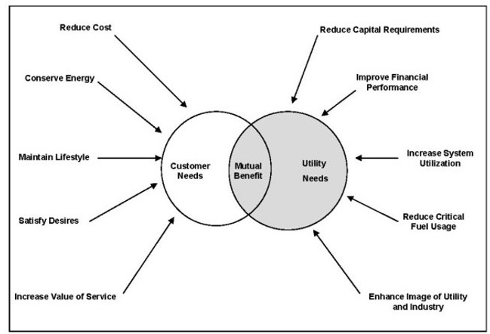
Scope of DSM

Slide 11
Benefits of DSM
Benefits for supply industry/Utility
- Reduction in customers bill
-Reduction in new power plant,
transmission & distribution network
- stimulate economic development
- creating new long job opportunities on
innovation & technologies
-Reduction in air pollution
-Improving operating efficiency & flexibility
-Improving load factor

Slide 12
Benefits of DSM
2.Customers benefit
-Satisfy electricity demands
-Reduce/stabilize the cost
-Improve the value of service
-Maintain/improve life style & productivity
3.Social Benefits
-Reduce environmental degradation
-conserve resources
-protect the environment
-Maximize customer’s welfare

Slide 13
Benefits of DSM
Customer Benefits | Utility Benefits | Societal Benefits
Satisfy electricity demands | Lower cost of service | Reduce environmental degradation
Reduce / stabilize costs or electricity bill | Improve operating efficiency, Flexibility | Conserve resources
Maintain/improve lifestyle and productivity | Improve customer service | Protect global environment

Slide 14
Concept of DSM
DSM is a mechanism to influence customer’s CAPABILITY and WILLINGNESS to reduce electricity consumption.
DSM is an utility program aiming to fine-tune consumer’s energy consumption pattern, according to the utility’s energy production and distribution capacity.
Demand-side management(DSM) programs consist of the planning, implementing and monitoring activities of electric utility that are designed to encourage consumers to modify their level and pattern of electricity usage.

Slide 15
Concept of DSM
Utility
DSM
Consumer
Therefore consumers too have a very important role to play for achieving the objectives of DSM

Slide 16
How to Perform DSM …..?
To charge higher prices during Peak Hours
Improving the efficiency of various end uses by using energy efficient appliances, better house keeping and reducing energy leakages. This is important for agriculture where energy efficiency is very low (30-50%)
Promoting use of Energy Efficient Technologies and addressing Aggregate Technical and Commercial (AT&C) Losses

Slide 17
DSM Activities
Load management programmes: Redistribute energy demand to spread it more evenly throughout the day, e.g., load shifting programmes (reducing loads during periods of peak demand and shifting these loads to less critical periods), and time-of-use rates (charging more for electricity during periods of peak demand).
Conservation programmes: Reduce energy use, e.g., programmes to improve the efficiency of equipment, buildings, and industrial processes.
Strategic load growth programmes: Increase energy use during some periods, e.g., programmes that encourage cost-effective electrical technologies that operate primarily during periods of low electricity demand.

Slide 18
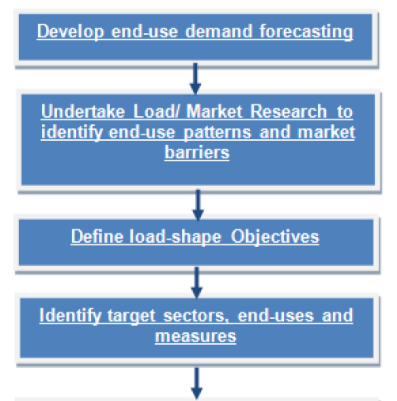
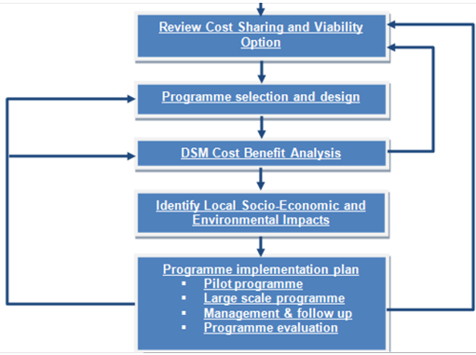
Planning & Implementation of DSM
@
@

Slide 19
Planning & Implementation of DSM
Develop end-use Demand forecasting
Forecasting by end-use is an essential pre-requisite for effective DSM planning and implementation.
Mid- and long-term forecasts of power demand variations play a very important role in the development of a DSM programme.
Demand forecasting is an exercise that every electricity-generating company should carry out regularly in order to assess its future equipment requirements.

Slide 20
Planning & Implementation of DSM
2. Undertake Load/ Market Research to identify end-use patterns and market barriers
To design effective DSM programmes it is important to know how electricity is used and what barriers are preventing customers from using efficient technologies.
Load research should be undertaken to estimate load curves for each sector or region, using local sub-metering, customer bill analysis and customer surveys.
Major areas of interest to DSM programmes include the residential, commercial, industrial, and public utility sectors.
Market research is needed to understand the target market, identify barriers and evaluate possible solutions.

Slide 21
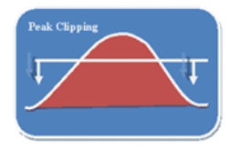
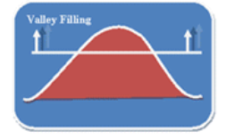
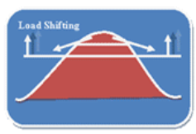
Planning & Implementation of DSM
3. Define load-shape objectives
Reduction in peak demand
Controlling the equipments
Controlled tariff rate
Increasing load during off peak
hours
Building off peak loads
Demand shift to off peak
Shift peak load to off peak
hours
Popular applications include
use of storage water heating, storage space heating, and
coolness storage.

Slide 22
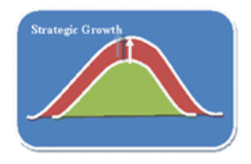
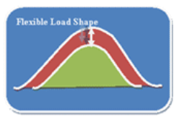
Planning & Implementation of DSM
3. Define load-shape objectives
The reduction of utility load,
more or less equally,
during all or most hours of the day
Non traditional approaches to
load management
The INCREASE of utility load
Load-shape change which
refers to overall increase in sales
The interruptible
agreements by
utility to alter
customer energy
consumption
on an as-needed basis

Slide 23
Planning & Implementation of DSM
4. Identify target sectors, end-uses, and measures
The collected information is normally useful in determining a typical load curve for each end-use.
Find out load-curve management objectives
Choose sectors and end-uses that account for the largest power consumption and peak loads, or will do so in the future.
Select DSM measures which will have the largest impact on peak demand and electricity use.

Slide 24
Planning & Implementation of DSM
5. Identify sources of financing
In any DSM programme, financing is needed for individual projects undertaken by participants.
Utilities may also require financing to cover administrative costs and cost sharing investments.
Government/public fund is required.

Slide 25
Planning & Implementation of DSM
6. Review Cost Sharing and Viability Options
Cost sharing in a DSM programme should try to maximize viability for each partner (participant, utility, and government).
If current tariffs are below the marginal cost of new power supply options, it is financially viable for the utility to share in the cost of the efficient technology and maximize participation in the programme.
The wider the differences between tariffs, the higher the utility investment can be, which in turn leads to a higher participation rate.

Slide 26
Planning & Implementation of DSM
7. Programme Selection and Design
Identifying a list of programmes for each customer class.
Formation of brief report corresponding to that program
Uniform reporting format is required.

Slide 27
Planning & Implementation of DSM
8. DSM Cost/Benefit Analysis
Based on the case study /measurement
Calculation of financial interest
9. Identify Local Socio-Economic and Environmental Impacts
Most DSM programmes provide indirect economic and environmental benefits as well as reducing emissions and other impacts from power supply facilities.
Eg. employment is created in the energy services industry

Slide 28
Planning & Implementation of DSM
10. programme Implementation Plan
Implementation of any DSM programme requires a core DSM staff or “cell” within a power utility to develop a plan.
For the programme and manage its implementation, even if consultants are hired for both aspects of the programme.

Slide 29
Elements of DSM Implementation
Staffing plan and job descriptions for different aspects of the programme – contracting, marketing, supervision, monitoring and evaluation.
Standard contracting procedures for direct installation, marketing, and standing offers or bidding procedures for energy service companies.
A promotion/marketing plan to maximize participation.
A schedule of activities with participation targets for each year of the programme.
A budget and expenditure plan.

Slide 30
Different techniques of DSM
Time Of Day (TOD) pricing & metering
Multi utility power exchange model
Load management
Load priority techniques
Peak clipping
Peak shifting
Strategic conservation
Energy efficiency improvement
Different time zones
Tariff intervention
Rain water harvesting

Slide 31
Different techniques of DSM
1.Time Of Day (TOD) pricing & metering
The rate which vary according to the time of the day is called ‘Time of Day Pricing (TOD).
TOD is already practicing in India for HV installation, industries & large commercial installations
Should extend to other installation India for all types of load.

Slide 32
Different techniques of DSM
2. Multi-utility power exchange model
All utilities are connected by a grid.
In order to handle or manage the peak demand grid shifting is allowed.
Condition:-Peak load handling capacity < 10% difference between peak load & average load

Slide 33
Different techniques of DSM
3. Load Management
Change the consumer’s electricity use pattern.
Technique which improving the effective utilization of generating capacity.
Encourage best usage of electricity.
It is for reducing outages & improving reliability.
Load management involves planning, developing & implementation program.

Slide 34
Different techniques of DSM
3. Load Management
Load factor= Average load
Maximum demand
Keep the value of load factor to be high.
Different load control techniques are available
Direct load control technique, local load control technique & distributed load control techniques.

Slide 35
Different techniques of DSM
4.Load priority technique
a) Direct load control technique –
Utility control the consumer’s load without any interaction.
Eg. Power line carrier or ripple control system (using in Europe)
b) Local load control technique –
Consumer control the load
One method is to have a circuit breaker at the consumer premises
When the load exceed the predetermined value circuit breaker will operate and supply is switched off

Slide 36
Different techniques of DSM
4.Load priority technique
c)Distributed control technique
In this techniques consumer control their load in communication with utilities.
Applicable for large industrial consumer.
They have special contract such as interruptible load.

Slide 37
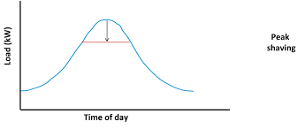
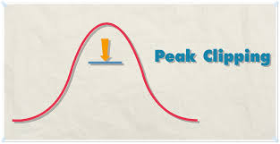
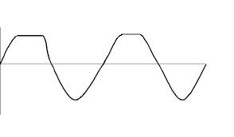
Different techniques of DSM
5. Peak clipping
Reduction in peak demand
Controlling the equipments
Controlled tariff rate

Slide 38
Different techniques of DSM
5. Peak clipping
Shifting electricity consumption from peak to non peak hours.
One of the classical form of load management.
Here some consumer's appliances switched off by direct load control technique.
It will be more beneficial for large industrial consumers.

Slide 39
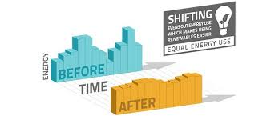
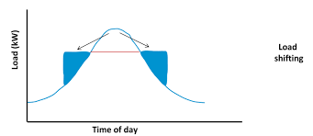
Different techniques of DSM
6.Load shifting
Increasing load during off
peak hours
Building off peak loads

Slide 40
Different techniques of DSM
6.Load shifting
Reduction of utility loads during period of peak demand.
Building the load in off peak period
Some appliances switched off during peak demand.

Slide 41
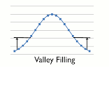
Different techniques of DSM
7.Valley filling
Increasing load during off peak
hours
Building off peak loads

Slide 42
Different techniques of DSM
7.Valley filling
Improve the load factor.
Building load in off peak period.
Some heavy appliances (irrigation pump, water heaters etc) are switched off during peak hours & switched on during off peak hours.
This technique is known as valley filling.

Slide 43
Different techniques of DSM
8. Strategic Energy Conservation
Conserve the energy
Eg. Photo sensitive switches for street light
Reduce KVAR of the load.

Slide 44
Different techniques of DSM
9. Strategic load growth
Support for valley filling
Meet the load requirement

Slide 45
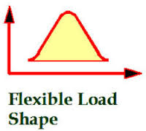
Different techniques of DSM
10.Flexible load shape
The utility is allowed to adjust
the load shape to meet the
reliability constraints.
The consumers are given incentives for reduced level of service.

Slide 46
Different techniques of DSM
11. Energy Efficiency Improvement
End use energy conservation
Least cost utility programs
Promotion of high energy efficiency technologies

Slide 47
Different techniques of DSM
11. Energy Efficiency Improvement
(a) End use energy conservation
Reduce the electricity consumption of consumers side.
Reduce electricity bill for consumers
Utilities and governments undertake various programs like education programes, subsidies for energy efficient equipments, developing energy efficient equipments, equipment efficiency standards etc.

Slide 48
Different techniques of DSM
11. Energy Efficiency Improvement
(b) Least cost utility programs
Supply side efficiency improvement
Addition of new project
Research on energy efficient equipment

Slide 49
Different techniques of DSM
11. Energy Efficiency Improvement
(c) Promotion of high energy efficiency technologies
High energy efficient technologies has been implemented in many of the countries.
A few energy efficient technologies are electronic ballast for fluorescent light, variable speed drive using power electronic devices etc.

Slide 50
Different techniques of DSM
11. Energy Efficiency Improvement
(c) Promotion of high energy efficiency technologies
- Energy conservation opportunities in illumination system
Lumen efficiency of incandescent lamp=12lumen/watts & CFL = 60-70 lumen/watts
Use CFL to achieve higher efficiency & long life
CFL is ecofriendly
Colour rendering property

Slide 51
Different techniques of DSM
11. Energy Efficiency Improvement
(c) Promotion of high energy efficiency technologies
Energy conservation opportunities in illumination system
Remove conventional choke (consumes 12-15W power) & use electronic ballast (high power factor and consumes only 1-4W of power)
High pressure sodium vapour lamp & mercury vapour lamp preferred for street lighting.

Slide 52
Different techniques of DSM
11. Energy Efficiency Improvement
(c) Promotion of high energy efficiency technologies
-Energy conservation opportunities in fan & refrigerator
Use high efficiency fan motor
Use electronic fan regulator
Fan with aero dynamic design & improved impeller design save 10% of energy consumption
Improved compressor design in refregerator

Slide 53
Different techniques of DSM
11. Energy Efficiency Improvement
(c) Promotion of high energy efficiency technologies
-Energy conservation opportunities in cooling & heating system
Improved design of building & ventilation
Improved thermostat & control
Improved efficiency of fan motor & water circulating pump

Slide 54
Different techniques of DSM
11. Energy Efficiency Improvement
(c) Promotion of high energy efficiency technologies
Energy conservation opportunities in Industrial sector
Use energy efficiency motors
Power electronic variable speed drive

Slide 55
Different techniques of DSM
11. Energy Efficiency Improvement
(c) Promotion of high energy efficiency technologies
Energy conservation opportunities in Agriculture area
Use solar & wind energy
Use energy efficient motor for pump set
Efficient irrigation pump
Proper design of swine creep heating system- heat pad controller, creep high temperature cutout thermostat.
Optimized design of efficient live stock water bowls.
Efficient design of ventilation fans.
Vacuum pump motors (e.g., variable speed drives).

Slide 56
Different techniques of DSM
11. Energy Efficiency Improvement
(c) Promotion of high energy efficiency technologies
Energy conservation opportunities in Agriculture area
Agriculture sector consumes 30% of total electricity in india
Total number of pump sets are 11850000 & about 2 lakh pump sets are added every year.
It is clear that improved efficiency of agriculture pump set can lead enormous saving.
Use of inefficient motor in the pump set leads huge wastage.
Use pumps & threshers during off peak hours

Slide 57
Different techniques of DSM
12.Tariff Intervention/ Tariff option for DSM
Tariff structure should be an efficient use of resources.
In order to achieve effective tariff consumer should receive correct information about the cost involved in delivering power.
Tariff should lead to a balance between supply & demand.

Slide 58
Different techniques of DSM
12.Tariff Intervention/ Tariff option for DSM
Proper tariff should be applied so as to improve the load factor.
A proper tariff structure can itself lead to peak clipping & valley filling.
This can be improved service to consumer & load shedding may not be required.

Slide 59
Different techniques of DSM
12.Tariff Intervention/ Tariff option for DSM
Types of DSM tariff are
a) Time of day tariff ( TOD Tariff)
b) Seasonal tariff
c) Curtailable / Interruptable Rates (C/I Rates)

Slide 60
Different techniques of DSM
12.Tariff Intervention/ Tariff option for DSM
Time of day tariff ( TOD Tariff)
TOD rate makes electricity cost more expensive during peak hours & cheaper during off peak hours.
Such tariff encourage the consumer to shift the load from peak hours to off peak hours.
TOD metering is required for implementing this type of tariff.

Slide 61
Different techniques of DSM
12.Tariff Intervention/ Tariff option for DSM
b)Seasonal tariff
In this tariff the rate changes across the season
This type of tariff is an economical way of metering demand.
Peak consumption month- changing more
No need of separate TOD meters.

Slide 62
Different techniques of DSM
12.Tariff Intervention/ Tariff option for DSM
c) Curtailable / Interruptable Rates (C/I Rates)
C/I rates offer incentives to those consumers who reduce demand to a predetermined level.
C/I rates are suitable for only the industrial and commercial consumers
The success of this tariff depends on reliable communication system.

Slide 63
Different techniques of DSM
13. Different time zone
Shifting of peak load from one to other time zone.
Peak hours & off peak hours
Shift the equipment (load) from peak hours to off peak hours
Consumers electricity bill can be reduced.

Slide 64
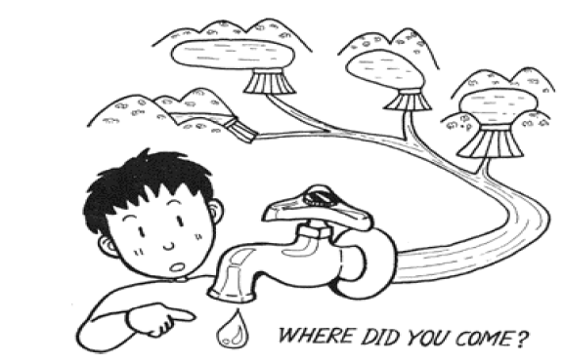
Different techniques of DSM
14. Rain water harvesting

Slide 65
Different techniques of DSM
14. Rain water harvesting
Rainwater harvesting, in its broadest sense, is a technology used for collecting and storing rainwater for human use from rooftops, land surfaces or rock catchments using simple techniques such as jars and pots as well as engineered techniques.
The application of appropriate rainwater harvesting technology is important for the utilization of rainwater as a water resource.

Slide 66
CRITERIA FOR SELECTION OF MOTORS
It is always advisable to select a motor with highest efficiency.
Power factor is also very important. However power factor can be corrected by external capacitor; but efficiency cannot be corrected.
Cost of motor is in significant when compared to the running cost.
Efficiency should be one of the determining factors in purchase of motors, besides cost. Decision is to be strictly on comparative cost-benefit analysis.

Slide 67
CRITERIA FOR SELECTION OF MOTORS
Generally reluctance is observed in replacing a good condition but inefficient or oversized motor. A cost-benefit analysis will help in such cases to take a decision.
Whenever possible, higher speed motors should be preferred. Higher the speed, higher is the efficiency.

Slide 68
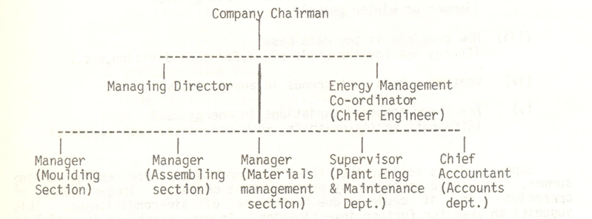
Management & Organization of Energy Conservation program
Basic structure of energy management in an organization

Slide 69
Management & Organization of Energy Conservation program
Plant level organization
Division level organization
Corporate level organization

Slide 70
Management & Organization of Energy Conservation program
Plant level organization
Applicable for a single plant
Monitoring the energy conservation for a single plant unit
Applicable for both small & large plants
Plant energy conservation coordinator is the key person of the organization.
Plant energy conservation coordinator submit report on energy conservation report to the management.

Slide 71
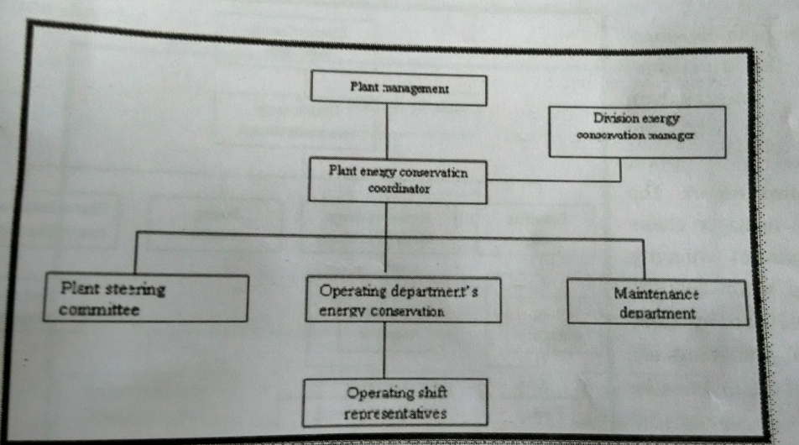
Management & Organization of Energy Conservation program
Plant Level organization

Slide 72
Management & Organization of Energy Conservation program
1.Plant level organization
It will be complicated for large plant
Operating shift management
Based on a single plant
Short term basis

Slide 73
Management & Organization of Energy Conservation program
2.Divisional level organization
Monitoring of energy conservation process for several plant units
Medium term (quarterly) basis
It involves transfer of useful information between similar plants.
Division energy conservation manager plays key role in this category.

Slide 74
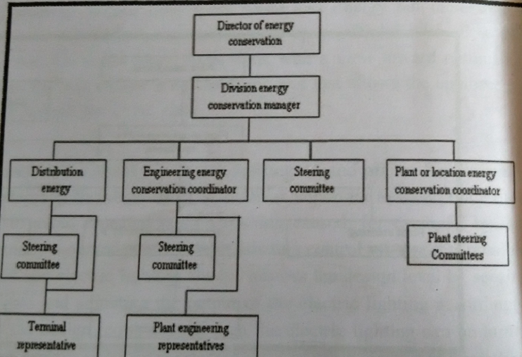
Management & Organization of Energy Conservation program
Divisional Level organization

Slide 75
Management & Organization of Energy Conservation program
2.Divisional level organization
Steering committee plans the energy conservation progrmme.
Steering committee generates the ideas for employee awareness, technical projects & improved operating procedure.

Slide 76
Management & Organization of Energy Conservation program
3.Corporate level organization
Large multi divisional organization belongs corporate level organization.
Energy conservation report directly forward to top level management.
It involves the contribution of representatives from various business organization.
Division managers report directly to the director of energy conservation.

Slide 77
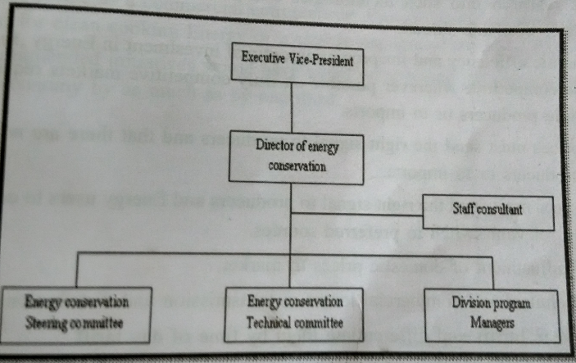
Management & Organization of Energy Conservation program
Corporate Level organization

Slide 78
Energy efficient technology
1.Maximum demand controller
2.Automatic power factor controller
3.Soft starter with energy saver
4.Variable speed drive
5.Energy efficient transformer
6.Electronic ballast
7.Occupancy sensors
8.Energy saving potential of each technology
9.Energy efficient motors

Slide 79
Energy efficient technology
1.Maximum demand controller-
Preset Value of maximum demand is programmed in the device
If the maximum demand approaches the preset value alarm is sounded/ Indicator.
It can be implemented by using a suitable contactors.
2.Automatic power factor controller-
Using relay/microprocessor logic
Mainly two types
(a) Voltage control (b)KVAR control

Slide 80
Energy efficient technology
2.Automatic power factor controller-
Voltage control
Check the voltage drop when load is applied
Less voltage drop supporting for leading power factor
Suitable at substation
(b)KVAR control
Current & voltage sense from the feeder & processed by using microprocessor.
Sensitive control, where voltage variation aren’t available
(c)Automatic power factor control relay
(d)Intelligent power factor controller

Slide 81
Energy efficient technology
3.Soft starter with energy saver
Starting current & starting torque is very high during the starting of induction motor.
It will effect windings, belt, chain etc
Star delta starter provide a partial solution for this problem but not complete solution.
Soft start & soft stop is built into 3 phase units provide controlled starting & stopping with a selection of ramp time & current limit settings to suit all applications.

Slide 82
Energy efficient technology
3.Soft starter with energy saver
Advantages are
Less mechanical stress
Improved power factor
Lower maximum demand
Less mechanical maintenance

Slide 83
Energy efficient technology
4.Variable speed drives
- Speed control of induction motors- Speed can vary by using voltage, varying rotor resistance, Scherbius or Kramer drives etc
Variable frequency drives- Control the speed by changing the frequency
V/f control

Slide 84
Energy efficient technology
5.Energy efficient transformer
Amorphous core material- metalic glass alloy
Less heat/vibration losses
Reduced hysteresis losses
6.Electronic Ballast
Ballast act as the choke
Auxiliary circuit for starting of fluorescent lamp

Slide 85
Energy efficient technology
7.Energy efficient lighting control
(a)Occupancy sensors
It is achieved by using infrared or uv or microwave sensors
Depending upon the occupancy lighting is controlled automatically
(b) Time based control
By using photo cells or LDR

Slide 86
Review Questions
Explain the energy efficient technology in electrical system. June/July 2014. 10 Marks
Briefly explain the DSM planning and implementation . June/July 2014,2011,2010. 10 Marks
Explain energy conservation opportunities in illumination and industrial sector. June/July 2014. 10 Marks
Write a short notes on: i)peak clipping ii)load shifting iii)valley filling June/July 2014, Dec 2011.,2010 10 Marks

Slide 87
Review Questions
5. Describe the benefits of demand side management.
10 Marks December 2011
6. Describe the some of the important types of tariffs, commonly used. 10 Marks December, june/july 2011, dec 2010
7. Explain the terms, maximum energy efficiency and maximum cost effectiveness. 10 Marks December 2011.
8. With the flow chart, explain the management and organization of energy conservation awareness
Programs. 10 Marks December 2010.

Slide 88
Review Questions
8. Explain various DSM strategies from load curve objective view. Mention benefit of strategies . June/July 2011, 10 Marks
9. Explain the energy conservation opportunity in agriculture sector. June/July 2011, 06Marks
10. Explain the plant level management organization with relevant diagram. June/July 2011, 08 Marks

Slide 89
Review Questions
11.Define DSM and explain the concept of DSM.
06 Marks
12. Explain the load management as DSM strategy.
06 Marks
13. Explain the basic ways of load shape objectives of DSM. 08 Marks
January 2010

Slide 90
Review Questions
14. Explain energy conservation opportunities in illumination systems.
06 Marks
15. With a flow chart, explain corporate level organization of energy conservation program.
06 Marks
16. What is time of day pricing? With the help of suitable example, explain how this help in an efficient DSM. 08 Marks
January 2010

Slide 91
Review Questions
17. Explain the concept and benefits of DSM.
10 Marks
18. Briefly explain the DSM Planning and implementation.
10 Marks
19. Explain the importance of management and organization of energy conservation awareness programs.
10 Marks
20. Explain with an example, the Time-of-day pricing.
10 Marks
June 2012

