Slide 1
Energy Auditing & Demand Side Management Unit 4 ELECTRICAL SYSTEM OPTIMIZATION
Prepared by
Prof. S.D.Hirekodi
Assistant Professor
Dept of EEE
HIT-Nidasoshi

Slide 2
Syllabus- unit 3
Electrical System Optimization
The power triangle, motor horsepower, power flow concept.
8 Hours

Slide 3
Objectives
To study the various components of power triangle.
To analyze the importance of Motor Horse Power(HP).
To analyze power flow diagram of AC power system.
To understand Power flow concept.
To learn what is Plant Energy Performance (PEP).
To learn about Product Factor.

Slide 4
Power Triangle
Why power triangle?
To calculate & analyze the total power requirement of a load.
To calculate the power factor of a load.

Slide 5
Power Triangle
Importance of power triangle
80% of industrial loads have inductive nature
Total power requirement of the load includes Resistive part and inductive part (Two-components)
It is not possible to add two components directly
Power triangle is required for this condition.

Slide 6
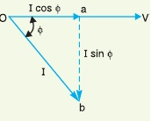
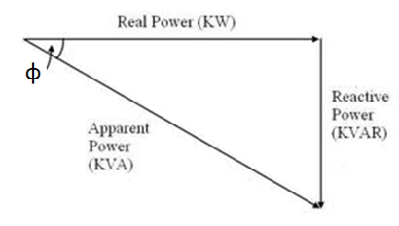
Power Triangle
Importance of power triangle
Multiply by V for each components
O
A
B
Current triangle
power triangle

Slide 7
Power Triangle
Importance of power triangle
OA=VI cosφ and represents the active power or Real power or True power in watts or kW.
AB =VI sinφ and represents the reactive power in kVAR.
OB=VI and represents the apparent power in kVA.

Slide 8
Power Triangle
Importance of power triangle
The apparent power in an AC circuit has two components viz., active and reactive power at right angles to each other. OB^2=OA^2+ AB^2
Power factor, cosφ=OA/OB= active power/ apparent power=kW/kVA.
Thus the power factor of a circuit may also be defined as the ratio of active power to the apparent power.

Slide 9
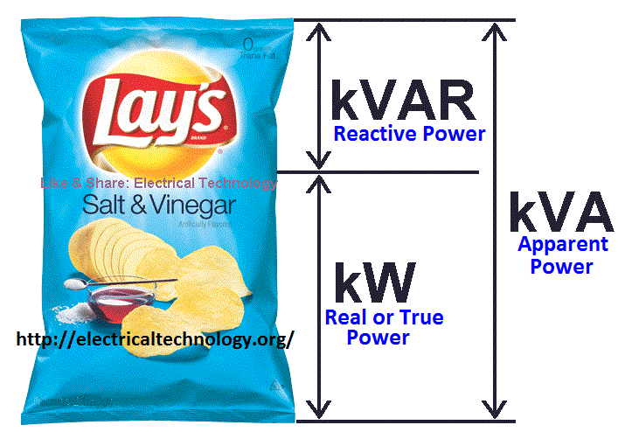
Power Triangle
Importance of power triangle
Reactive power
The reactive power neither consumed in the circuit nor it do any useful work
It merely flows back & forth in both direction in the circuit.
A wattmeter doesn’t measure reactive power.

Slide 10
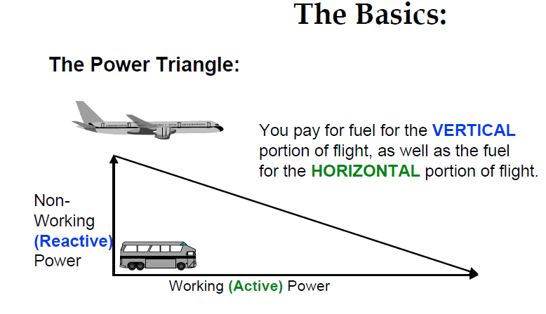
Power Triangle
Importance of power triangle
Reactive power Concept:-

Slide 11
Review Questions on Power Triangle
With the vector diagram, explain various components of power triangle. (june/july 2014, 2011 08 Marks)

Slide 12
Motor Horse Power (HP)
It is a standard rating of a motor
Motor output rating
1 HP= 746 Watts
Invented by James Watt who compares the output of steam engine with draft horse.
Types of Horse Power are (i) Mechanical Horse Power (ii) Metric Horse Power (iii) Electric Horse Power (iv) Boiler Horse Power (v) Hydraulic Horse Power.

Slide 13
Motor Horse Power (HP)
Calculation of horse power
P_{HP=} (ɳ_{m*}V*I)/(746)
V= Input Voltage
I= Input Current
ɳm= efficiency of motor

Slide 14
Motor Horse Power (HP)
Eg1. The power of an 230V electrical motor with 85% of efficiency having 10A of current. Calculate the Horse Power of a Motor.
PHP = ( 0.85*230*10)/746
= 2.62 HP

Slide 15
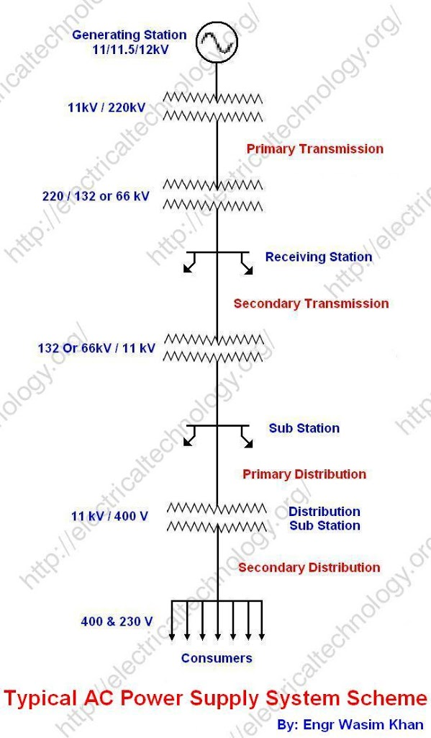
Typical AC Power System

Slide 16
Typical AC Power System
The function of electric power system is to connect the power station to the consumers load by means of inter connected system of transmission & distribution network.
Structure of power system becoming complex depending upon the demand.
Generation
Power System
Primary
transmission
Transmission
Secondary
transmission
Distribution
Primary
distribution
Secondary
distribution

Slide 17
Typical AC Power System
Generating Station
Electrical power is produced by 3phase alternator connected in parallel
Usual generation voltage is 11kV due to economic consideration.
High voltage transmission is recommended because of the following reasons (i) save the conductor material (ii) Improve the transmission efficiency.
11kv 132kV or 220kV
Step up transformer

Slide 18
Typical AC Power System
(ii) Primary transmission
132kV is transmitted by 3phase, 3 wire system to the outskirt of the city called it as primary transmission.
(iii) Secondary transmission
132 kV 33 kV
3phase, 3wire system is recommended
Step down transformer

Slide 19
Typical AC Power System
(iv) Primary distribution
33kv 11kv
3phase, 3wire system is recommended
Big/bulk consumer can directly access the power
Those demand may greater than 50kW.
Step down transformer

Slide 20
Typical AC Power System
(iv) Secondary distribution
Electric power from the primary distribution line (11kV) is delivered to distribution substation.
Substation is located near to consumer premises
Step down the voltage to 400V, 3phase, 4 wire system
Voltage between any 2 phases= 400V
Voltage between any phase & neutral =230V

Slide 21
Typical AC Power System
(iv) Secondary distribution
It includes i) feeders ii) Distributors & iii) Service mains.
Loads are connected to distributors through service mains.

Slide 22
Review Questions
Write a short note on primary & secondary distribution. (june/july 2014, dec 2011, 04 Marks)
Layout of typical AC power system .( Dec 2011, june/july 2011, Dec 2010, June 2012, 08 Marks)

Slide 23
Power Flow Concept
Power flow is analogous (similar) to water flowing in a pipe.
Larger water tank Smaller tank unit
Pressure reducing valves are available to reduce main pressure & meet the requirement.
Pressure reducing component is equivalent to switch gears, breakers & main feeders in the situation of electrical system.
Transformers are used to reduce the voltage level without frequency change.

Slide 24
Plant Energy Performance
What is Plant Energy Performance (PEP) ?
It is a performance indicator of energy management programmer.
Measure of how well energy management program is going on.
Plant energy performance is the measure of whether a plant is now using more or less energy it’s product than it did in the past.

Slide 25
Plant Energy Performance
What is Plant Energy Performance (PEP) ?
Keep one year as a reference year and check the performance of further year.
Checking the improvement.
It will give the significant information about plant energy use.
The improvement or deterioration from the reference year is called energy performance.

Slide 26
Plant Energy Performance
What is Plant Energy Performance (PEP) ?
PEP= (Reference year equivalent- Current year
energy)
*100
Reference Year equivalent
Where Reference year equivalent = Reference year energy use * production factor
Definition for Reference year equivalent:- Reference year energy use that would
Have been used to produce the current year’s production output may be called
As reference year equivalent.

Slide 27
Plant Energy Performance
If the energy performance is high greater the improvement.
PEP is directly proportional to improvement in energy management.

Slide 28
Production Factor
It is the ratio of production in the current year to that in the reference year.
Production factor= Current years production
Reference years production
The production factor is used to determine the energy that would have been required to produce this years production output if the plant had operated in the same way as it did in the reference year.

Slide 29
Review Questions
1.Explain energy performance & power flow concept. (June/july 2014, 08 Marks)
2. What is Plant Energy Performance (PEP)? Define the production factor. (Dec 2010, 05 Marks)

Slide 30
How to maximize the system efficiency???????????
Proper design
Proper maintenance
Regular inspection
Proper lubrication
Provide efficient lighting system
Provide air filters
Select high quality of equipment
Provide good training for the employees
Eliminate the steam leakage
“Task in energy use”

