Slide 1
Energy Auditing & Demand Side Management Unit 1 INTRODUCTION
Prepared by
Prof. S.D.Hirekodi
Assistant Professor
Dept of EEE
HIT-Nidasoshi

Slide 2
Syllabus- unit 1
Introduction:
Energy situation – world and India, energy consumption, conservation, Codes, standards and Legislation. 6 Hours

Slide 3
Overview –Unit 1
Learning Objectives
Importance of Energy & Energy Sources
Classification of energy sources
World energy scenario
Indian energy scenario
Energy Conservation
Laws, Acts, Codes, Rules & Regulation related to Energy Sector

Slide 4
1.Learning Objective
Understanding the importance of energy.
Classification of energy sources.
Discussion about energy scenario in India.
Discussion about energy scenario in World.
Energy conservation techniques used to reduced energy cost.
Description on Electrical Distribution Code with respect to supply system

Slide 5
Learning Objective continued…..
Study on Standard with respect of Electrical Supply System.
Objectives of Energy Conservation Act 2001.
Understanding the issues addressed by Energy Conservation Act 2001.
Features of Indian Electricity Act 2003.
Features of Indian Electricity Rule 1956.

Slide 6
2.Importance of Energy
“Energy is fundamental to daily life. Whether it is providing light for our class room, refrigeration for our food & medicine, pumps to irrigate our crops, or electricity to run our commercial and industrial enterprises, energy provides the means of economic growth and social and political development”- USAID
USAID- United State Agency for International Development
Energy is the major inputs of economic development of any country

Slide 7
Energy Sources
Coal
Lignite
Petrol
Diesel
Furnace oil
Kerosene
LPG
Natural Gas
LNG
Electricity- Thermal, Hydro, Nuclear, Wind, Solar, Biomass etc

Slide 8
Classification of Energy Sources
Energy Sources
Primary and Secondary Energy Sources
Commercial and
Non Commercial
Energy Sources
Renewable and Non- Renewable
Energy Sources

Slide 9
Classification of Energy Sources contd…
Primary & Secondary Energy sources
Fossil fuels, Radioactive substances, Earth interior, Earth gravity are the examples of primary energy sources.
Common primary energy sources are fossil fuels.
Coal, Lignite, oil, natural gas, petrol, diesel biomass etc are the derivatives of fossil fuels.
Nuclear energy is obtained from radio active substances
Thermal energy stored in earth interior
Potential energy due to earth gravity

Slide 10
Classification of Energy Sources contd…
The primary energy sources are mostly converted in industrial utilities into secondary energy sources.
Eg. Coal or Gas
Steam, Electricity etc are the examples of Secondary Energy Sources.
Steam and Electricity

Slide 11
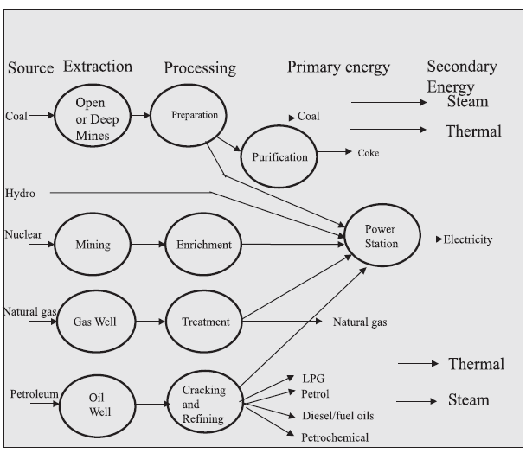
Classification of Energy Sources

Slide 12
Classification of Energy Sources contd…
(2)Commercial and Non commercial Energy sources
Commercial Energy Sources
Electricity, Coal, lignite, refined petroleum products & natural gas are the important commercial energy sources.
These energy sources using for industrial, agricultural, transport & commercial development in the modern world.

Slide 13
Classification of Energy Sources contd…
(2)Commercial and Non commercial Energy sources
Non-Commercial Energy Sources
Traditional fuels like firewood, cattle dung, agro wastes are grouped into non commercial energy sources
Solar energy, Wind energy & animal power also categorized into non commercial energy sources
Solar energy- water heating, Electricity generation, Drying grain, fish & fruits.
Wind energy-Electricity generation & water lifting
Animal power-water irrigation, transportation & crushing sugar cane

Slide 14
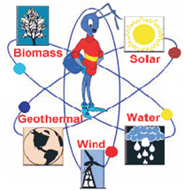
Classification of Energy Sources contd…
(3) Renewable and Non-Renewable energy sources
Renewable energy sources
The renewable energy is obtained from sources that are essentially inexhaustible.
Eg. Solar energy, wind energy, geothermal energy, tidal energy, hydro electric power & biodiesel
Clean & pollution free
Ecofriendly

Slide 15
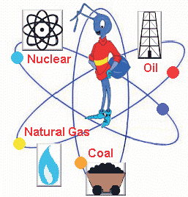
Classification of Energy Sources contd…
(3) Renewable and Non-Renewable energy sources
Non-Renewable energy sources
Coal, natural gas, oil, Nuclear energy are collectively grouped into non renewable energy source.
Depleting with time
Pollution

Slide 16
Quick Review-Importance of energy & Energy Sources
Q. Explain how energy sources are classified broadly? Give examples of each classification.
09 Marks
(vtu, june/july 2011)

Slide 17
World Energy Scenario
Introduction
Global primary energy consumption
Energy consumption in developing countries
World energy consumption projections
Outlook for primary energy consumption
World energy resource overview
World reserves of primary energy sources (i)coal, (ii)oil and (iii)gas.

Slide 18
World Energy Scenario
Introduction
Energy demand in all over the world is increasing day by day.
Major growth in energy demand is projected in developing countries & 2 billion people lack access to affordable & reliable energy.
Coal, Oil & gas are the three major primary sources of energy.
World coal reserves are likely to last over 200 years
Both oil & gas reserves likely to last 45-65 years
International Energy Outlook 2014 says that -Strong growth for world wide energy demand over the 24 years projection period from 2001-2025.

Slide 19
World Energy Scenario
Introduction continued..
Coal, Oil & gas are the three major primary sources of energy.
Among three major primary sources of energy coal consumption is heavily concentrated for electricity generation.
Almost 65% of world’s coal use is for electricity generation
Coal consumption is highest in china
About 40% of the world’s population depends on firewood and charcoal as their primary energy source.

Slide 20
World Energy Scenario
Introduction continued..
Rapid studies are going on for development and adoption of new sources of energy, even if petroleum remains primary source all over the world.
Commercial exploitation of oil in USA in 1859 & importance is increased
In 1920, 95 million tones of oil was produced & 4 billion ton in 2003. As of now the production increased 3000 million metric tones (MMT)

Slide 21
World Energy Scenario
Global primary energy consumption
The global energy consumption at the end of 2003 was equivalent to 9741 Million Tones of Oil Equivalent (MTOE)

Slide 22
World Energy Scenario
Energy consumption in developing countries
The developed countries attributable to high energy consumption as comparing developing countries.
80% of world population lies in developing countries. Their energy consumption amount is only 40% of the world’s total energy consumption.
Developing countries - Low per capita in the energy consumption.
The world average energy consumption per person is equivalent to 2.2 tonnes of coal.
Industrialized countries – people use 4-5 times more than world average energy consumption & 9 times more than the average of the developing countries.

Slide 23
World Energy Scenario
Energy consumption in developing countries
An American uses 32 times more commercial energy than Indian.!!!!!!!!

Slide 24
World Energy Scenario
World Energy Consumption projections
About 2 billions people lack access to affordable and reliable energy supplies in developing countries.
Women and children's are disproportionately burdened by depending on traditional fuels.
Strong energy demand growth is expected in 2001-25.
Primary energy consumption is projected to grow at an average annual rate of 2.7% between 2001-2005.
The total world consumption of marketed energy is expected to expand by 54% percentage. Ie 404 quadrillion Btu in 2001 to 623 quadrillion Btu in 2025.
Energy demand in India & China (asia) projected more than double over the next quarter century.

Slide 25
World Energy Scenario
Outlook of primary energy consumption
Coal usage is projected to increase 2.3 billion tonnes.
A sustainable decline in coal consumption at western & eastern Europe. But consumption of natural gas is increased for electric power generation.
In developing countries, it is projected the large usage of coal (approx.85%).
Oil is expected to remain dominant energy source throughout forecast period. (39% energy consumption) The oil consumption growth is 1.9% per year
Natural gas is projected to be fastest primary energy source world wide( 2.2% annually over 2001-25)
The nuclear power growth is expected 0.6% annually
Renewable energy consumption is expected to increase by 8% during 2011-25.

Slide 26
World Energy Scenario
World Energy Resources Overview
Compared to 1998 survey coal and natural gas consumption is increased somewhat and oil declined slightly.
Coal could contribute in a sustainable way to satisfy demand for energy from two billion people in the world today.

Slide 27
World Energy Scenario
World reserves of primary energy sources
As per the BP statistical review of world energy , June 2004 the energy reserves of 3 major primary energy sources like coal, oil & gas.
Coal-
Global coal reserve was estimated to be 984453 million tones by end of 2003.
USA-25.4% (highest share), Russia 15.9%, China 11.6% and India 8.6%
(ii) Oil-
Oil remains primary energy source all over the world
Global oil reserve was estimated to be 1147 billion barrels by the end of 2003.
Saudi has largest oil share reserves (approx. 23%)
1 barrel of oil= 160 liters

Slide 28
World Energy Scenario
World reserves of primary energy sources
(iii) Gas-
The current century is already being described as the “century of gas”.
Oil reserve are falling & potential gas reserve keep increasing
The global proven gas reserve was estimated to be 176 trillion cubic meters by the end of 2003.
The Russian federation had the largest share of gas resource (approx. 27%)

Slide 29
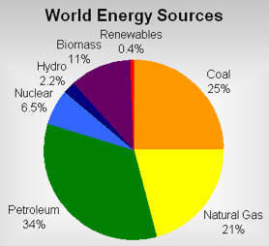
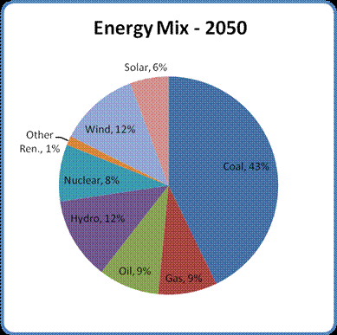
World Energy Scenario
World oil and gas reserves are estimated at just 45 years and 65 years respectively .
Coal is likely to lost a little over 200 years.

Slide 30
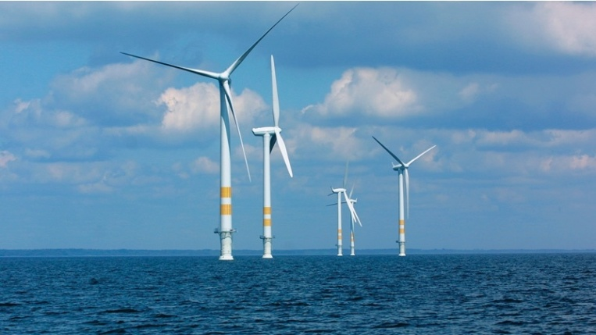
World Energy Scenario
Conclusion
Developed countries are consuming more energy
Energy demand will continue to grow strongly
Renewable sources will dominate
Investments need to be large
Strong environmental policies will be required
Energy system complexity will increase by 2050
Energy efficiency is crucial in dealing with demand outstripping supply.

Slide 31
Quick Review-World Energy Scenario
Q. Write a note on energy scenario of the world
08 Marks
(vtu, june 2012)
Seminar
“Renewable Energy Scenario in the world”

Slide 32
Indian Energy Scenario
Introduction
Sector wise energy consumption
India’s primary energy sources
Final energy consumption
Demand for commercial energy for final consumption
coal
Lignite
Oil
Natural gas
LNG
Electrical Energy

Slide 33
Indian Energy Scenario
Introduction
The electricity sector in India had an installed capacity of 255.012 GW as of end November 2014.
As of March 2013, the per capita total electricity consumption in India was 917.2 kWh.
India became the world's third largest producer of electricity in the year 2013 with 4.8% global share in electricity generation.

Slide 34
Indian Energy Scenario
Introduction
India’s absolute primary energy consumption is only 1/29th of world energy consumption.
As compared to America & Japan, absolute primary energy consumption is 1/7th & 1/1.6th respectively.
After the reformation the economic condition is little bit improved.
The implementation of Sustainable development made India is one of the fastest growing economies in Asia.

Slide 35
Indian Energy Scenario
Introduction
Economic growth of country proportional to consumption of energy.
As compared to developed countries per capita energy consumption is too low in India.
Energy usage in India is expected to rise to around 450 kgoe/year by 2010 from the present over 350 kgoe/year.
Note:- Kgoe- Kilogrammes of oil equivalent

Slide 36
Indian Energy Scenario
Introduction
In India, coal contributes 55% total primary energy consumption.
Oil production is declined from 20% to 17%
Gas production is increased from 10% (in 1994) to 13% (in 1999)
Oil production is declining because of poor availability in oil reserves.ie only 5.9 billion barrels (0.5% of global reserves)
India imports 70% of oil
India’s oil importing is increasing annually. (as of now 85% of importing & by the year of 2020, further to about 92%)

Slide 37
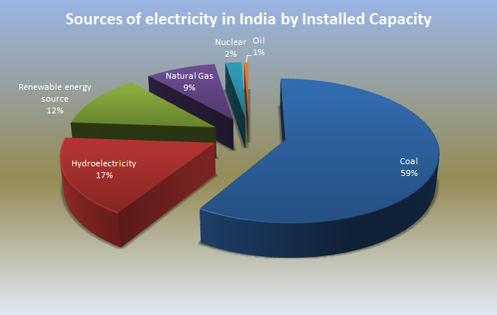
Indian Energy Scenario (As per 2013)

Slide 38
Indian Energy Scenario
Sector wise energy consumption
Major commercial energy consumption sectors in the country are classified into 4 major sectors.
They are agriculture, domestic, industry, transport & others.
Industry (49%), transport (22%), domestic (10%), agriculture(5%) and other remaining 14%.

Slide 39
Indian Energy Scenario
Per Capita Energy Consumption
Low per capita energy consumption

Slide 40
Indian Energy Scenario
India’s primary energy sources
Coal-
More than 50% of demand
8.6% of the world reserves
3rd largest coal producer after china & USA
70% heavy industry consuming coal
In 2000, coal consumption was 369 million tonnes & by the end of 2010 it was 450 million tonnes

Slide 41
Indian Energy Scenario
India’s primary energy sources
(ii) Lignite-
Second quality of coal
36,008 million tones are available in India
85% available in Tamil Nadu
Neyveli region- toppest lignite deposition
Central govt. established Neyveli Lignite Corporation limited in 1956.

Slide 42
Indian Energy Scenario
India’s primary energy sources
(iii) Oil-
India is one of the top 10 oil consuming country.
Oil satisfying 36% of total energy consumption
Oil consumption rate as follows
1950-51 : 3.50 MMT
2002-03 :112 MMT
2006-07 : 175 MMT
2008-10: 3.2 million barrels/day
Bombay high, upper Assam, Cambay & Krishna-godavari are the major location.
Oil consumption declining yearly
Currently India import crude oil from gulf nations(70%)
At the end of 2020 India import 92% of oil

Slide 43
Indian Energy Scenario
India’s primary energy sources
(iV) Natural Gas-
Clean & environment friendly
Faster growth
8.9% of total energy consumption
2002-03- gas production= 86.56MCMD
2006-07-gas production=103.08MCMD
The natural gas reserves in India are estimated at 600 billion cubic meters.
By 2025, 10% of electricity is generated by CCGT plant using gas or dual fuel naphtha(expensive)
Nearly 82% of annual gas production is consumed by power & fertilizer industry.

Slide 44
Indian Energy Scenario
India’s primary energy sources
(V) LNG- Liquefied Natural Gas
Natural gas is cooled extreme low temperature to liquefy & the liquid transport in cryogenic ships to destination.
Liquid occupies less volume.
At Receiving end liquid is degasified through process heating.
First LNG terminal Dahej in Gujarath with initial capacity of 5 million metric tones per annum(MMTPA) & which amounts 20 MCM/day.
Year 2004 is a new era for India Petroleum and signed 25 years ‘take -or- pay ‘ contract from ‘Qatar’s Ras Gas’ .
The marketing of gas being down by GAIL, Indian Oil Corporation & Bharath Petrolleum.

Slide 45
Indian Energy Scenario
India’s primary energy sources
(Vi) Electrical Energy
As on march 31st, 2005 all India electric power installed capacity was 118419MW (118.419GW).
The electricity sector in India had an installed capacity of 255.012 GW as of end November 2014.
-Thermal-69%, Hydro-26%, Nuclear-2% & Wind power-3%.
Hydro power potential is steadily decreasing.
Peak demand storage is around 14%
Deficit of energy is 8.4%

Slide 46
Indian Energy Scenario
India’s primary energy sources

Slide 47
Indian Energy Scenario
India’s primary energy sources
Required capacity in 2020 assuming 8% growth = 387,280 MW (387.280 GW)

Slide 48
Indian Energy Scenario
Final Energy Consumption
Final energy consumption is the actual energy demand at the consumer or user end.

Slide 49
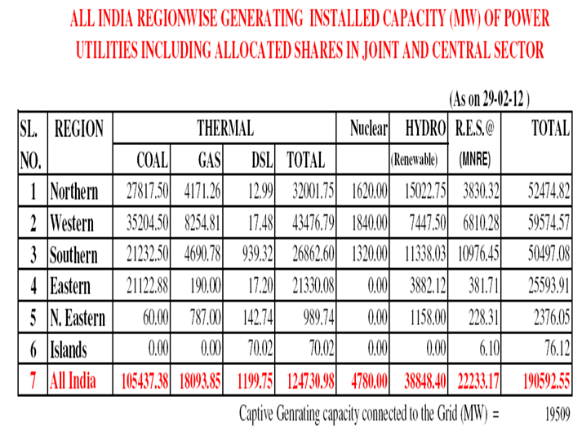
Indian Energy Scenario
Final Energy Consumption

Slide 50
Quick Review- Indian Energy Scenario
Describe the present energy situation in india. (vtu,dec.2011) 10 Marks
Write a brief note on energy scenario in india. (vtu, june/july 2011,2010) 06 Marks
Seminar
(a) “Renewable Energy Scenario in India”
(b) “Renewable Energy Scenario in Karnataka”
“ Organization for Renewable Energy Development”

Slide 51
Energy Conservation
Introduction- what is Energy Conservation?
Energy Efficiency
Three Pronged Approaches of Energy Management
(i) Capacity Utilization
(ii) Fine Tuning of Equipment
(iii)Technology Up gradation

Slide 52
Energy Conservation
What is energy conservation???????
Energy conservation is the process of saving of energy without affecting the actual work with or without investment.
“Reduction in the amount of energy consumed in a process or system or by an organization or society through economy, elimination of waste, and rational use”
Reduces the energy cost.
It can able to save up to 30% of energy.
Reduces the energy bill.
Reduces transmission & distribution line losses.
Reduces stress on the generator & plants

Slide 53
Energy Conservation
What is energy conservation???????
Conservation of energy refers to efforts made to reduce energy consumption and to increase efficiency of energy use.
Energy efficient equipments uses less energy for same output & reduces the environmental pollution like CO & CO2 emission.
Eg. Replacing 15W CFL Lamp with 60W Incandescent lamp saves 45W of power & reduces the emissions of CO2 by 49g/hr.
Initial investment is required for replacement it will coming back to consumer in energy bill.
Payback period should be calculated before replacing standard equipment with energy efficient equipment.

Slide 54
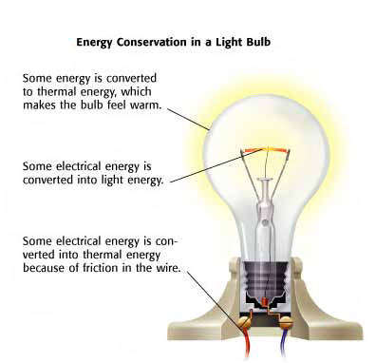
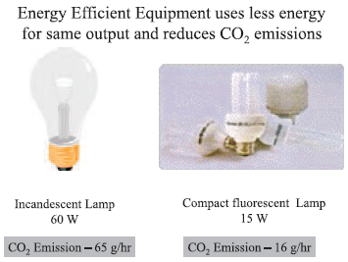
Energy Conservation
What is energy conservation???????

Slide 55
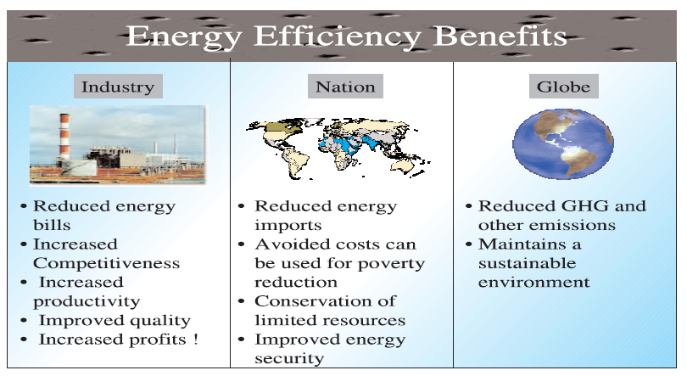
Energy Conservation
What are the energy efficient benefits????

Slide 56
Energy Conservation
Difference between Energy conservation & Energy efficiency?
Energy Conservation
Energy Efficiency
Energy Conservation is achieved
When growth of energy
consumption is reduced.
Energy efficiency is achieved
when energy intensity in a
specific product, process or
area of production or
consumption is reduced without
affecting output, consumption,
or comfort level.
Energy efficiency
promotes energy conservation

Slide 57
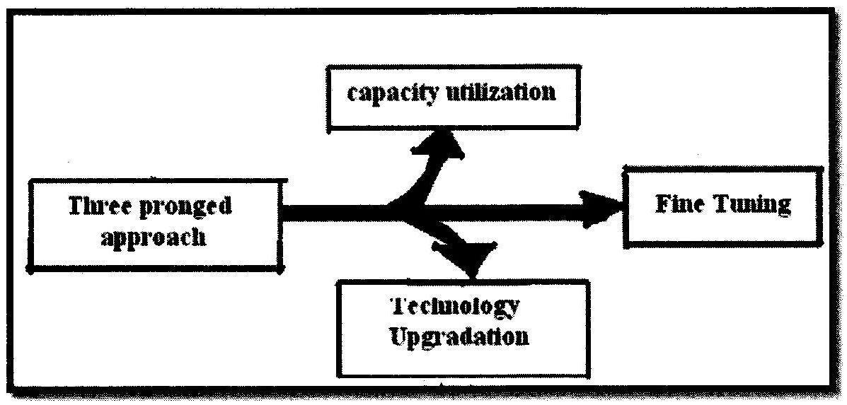
Energy Conservation
Three - pronged approaches to energy management

Slide 58
Energy Conservation
A study about 400 companies revealed that excellent energy efficient companies achieved lower specific energy consumption.
These companies adopt pronged (pointed) approach to energy management.
Pronged approach is developed by data collected through questionnaires from industries, diagnostic survey visits & through interaction with plant personals.

Slide 59
Energy Conservation
Explanation for 3 pronged approach to energy management
Capacity Utilization
Important for achieving energy efficiency
First and foremost step for achieving energy efficiency
Bring down the fixed energy consumption.
80% of energy efficient companies obeying capacity utilization
Can reduce specific energy consumption
Capacity utilization is under the control of plant personnel.

Slide 60
Energy Conservation
Explanation for 3 pronged approach to energy management
(ii) Fine turning of equipment
The fine turning of equipment should be taken by energy efficient plant.
Fine turning leads 3-10% of energy saving.
Only a few marginal investment is required for fine turning of equipment.

Slide 61
Energy Conservation
Explanation for 3 pronged approach to energy management
(iii) Technology up gradation
Ensure high saving potential
Applicable for a company targeting above 20% saving.

Slide 62
Quick revision-Energy Conservation
What is Energy Conservation? Explain.
04 Marks (vtu, june/july 2014)
2. Explain the energy conservation techniques used to reduce the energy costs. 06 Marks
(vtu, january 2010)

Slide 63
Standards & Legislations
Electrical Distribution Code
Standards of Electrical Equipments
Regulations
Other Legal Provisions

Slide 64
Electrical Distribution Code
There are certain rules of a particular electricity supply system, provision for metering, earthing & installation matters according with section49&79 of electricity supply act 1948.
Electricity(supply) act, 1948

Slide 65
Electrical Distribution Code
Summary of electricity(supply) act, 1948 includes the following:-
Administration information for grant of connections, billing, connected load, contract demand, disconnections, recovery of dues from defaulting consumer & dealing with theft of energy cases etc.
The system of supply and requirements for balancing single phase load on three phase system.
The limitation placed on water heaters, air conditioners, welders, electric motors, steel rolling mills, arc furnace etc…
Information regarding service lines, point of attachment of supply & fuses, charges over the switch etc
Provision necessary for all metering including the location accessibility and protection.
Requirements for consumer installations such as compliance with wiring rules, inspection & testing of installation.

Slide 66
Standards for Electrical Equipments
International Electrochemical Commission (IEC)
- IEC:60038- International Standards for
power supply- 50Hz,230V+10% or 230V-
10%
- Ensure the quality of power
- ISO:14001 for environmental mgmt. system for
improving surrounding resources like air, water,
land, natural resources fuels & humans.

Slide 67
Regulations
Indian Electricity Act 1910
The Electricity (supply) Act 1948
The Electricity Regulatory Commission Act,1998
The Electricity Act, 2003
Energy Conservation Act 2001
The Indian Electricity Rules 1956
Indian Telegraphic Act 1885

Slide 68
Regulations
The Indian Electricity Act, 1910
License- Grand of license, change the license
Works-opening & breaking of streets, railways etc.
Supply-point of supply, power to control the distribution & energy consumption, disconnection of supply
Transmission and use of energy by non licensees- control of transmission & use of energy
General protective clauses- Protection of railway, canals, railway & electric signals.
Administration & Rules- advisory board & appoinment of electrical inspectors.
Criminal offenses and procedures- theft of energy penalty, penalty for unauthorized supply, improper use of energy etc
Supplementary provisions- appointment of inspection staff, delegation functions

Slide 69
Regulations
2.The Electricity (Supply) Act 1948
Regulate production & supply of electricity
‘The central Electricity Authority’
‘State Electricity Board’-Regulation & Controlling transmission & generating companies
Coordination of regional electricity board
Annual report, statistics & returns
Board finance, account & audit
Penalties

Slide 70
Regulations
3. The electricity regulatory commission act, 1998
Establishment of the central Electricity regulatory commission.
Establishment of state electricity regulatory commission, central & state transmission utilities.
Framing grid & standards, regulating electricity tariff, regarding subsidies.

Slide 71
Regulations
4.The Electricity Act, 2003
National electricity policy and plan
Promoting competition, trading and development of electricity market.
Open access and parallel distribution
De-licensing, setting up and operating new generating stations, capitive generation & dedicated transmission lines.
Licensing transmission, distribution and supply companies
Duties of generating, transmission, distribution & supply companies
Direction of generating, transmission, distribution & supply companies
Compulsory consumer metering.

Slide 72
Regulations
4.The Electricity Act, 2003 contd….
Reorganization of state electricity board
Rationalizing subsidies
Constitution & functions of the central electricity authority, state regulatory commissions & appointment of advisory committees.
Works, Consumer protection & standard of performance.
Tariff regulations
Offences & penalties for theft of electricity, electric lines & materials, wasting electricity
Protection of railways, high ways, canals etc
Telegraph, telephone & electric signaling lines
Notice of accidents & inquiries
Appointment of electrical inspectors & miscellaneous provisions.

Slide 73
Regulations
5. Energy Conservation Act 2001.
This act concern about any forms of energy derived from fossil fuels, nuclear substance, hydro electricity & renewable energy sources.
The establishment & incorporation of the Bureau of energy efficiency.
Transfer of assets, liabilities etc of energy management center
Power and function of the bureau
Ensure the efficient use of energy and conservation (power of central govt. & state govt.)
Finance, accounts & audit of bureau
Penalties and adjudication

Slide 74
Regulations
5. Energy Conservation Act 2001.
Miscellaneous issues:-
Power to the state & central govt.
Power to remove difficulties

Slide 75
Regulations
6. The Indian Electricity Rules-1956
Based on section 37of Indian electricity act 1910.
The central electricity board has framed as Indian electricity rule
It containing 143 rules along with the detailed annexure & covers.

Slide 76
Regulations
6. The Indian Electricity Rules-1956 contd….
Inspection of electric installations- Creation of inspection agencies, inspection fees, appeal against order etc..
Licensing- Applications, contents & form of draft license, advertisement of application, preparation & submission of accounts & model condition of supply.
General safety precautions-Regarding construction , installation ,protection operation & maintenance of electric supply lines & apparatus, service lines & apparatus on consumer premises, identification of earthed conductors, intimation of accidents, periodical inspection, testing of consumer installation.

Slide 77
Description-Regulations
6. The Indian Electricity Rules-1956 contd…
General conditions relating to supply & use of electricity- Testing of consumers installations, Declared voltage & frequency of supply, sealing of energy & demand meter, point of supply, Electric supply lines, system & apparatus for low, medium, high & extra high voltages, Insulation testing, Testing of insulation resistance, earth connections, general condition for use and energy control, x ray installation
Overhead lines- Material and strength, clearness & supports, structure, condition to apply etc..
Electric traction- Rules & Regulation

Slide 78
Other Legal Provisions
1.Industrial Dispute Act, 1947
2.The factory Act, 1948
3. The trade union Act, 1926
4. The workmen compensation Act, 1923
5.Indian contract act,1872
6. Regulation for power line crossing of railway tracts, 1987
7. Pollution control act

Slide 79
Other Legal Provisions
Industrial Dispute Act, 1947
Investigation & settlement of industrial dispute in between employees & employers, employees and work men etc.
Controlling of illegal strikes, trade union, federation etc

Slide 80
Other Legal Provisions
2. The factory act, 1948
Distinction between seasonal & non seasonal factories.
Define minimum requirement of staff health, safety, welfare, workload, annual wage, leave, penalties etc.
Registration of new company/factory

Slide 81
Other Legal Provisions
3. Trade union act, 1926
Registration of trade union
Rights & liabilities
Regulation
penalties

Slide 82
Other Legal Provisions
4. Workmen compensation act, 1923
Injury & accident cases
5.Indian Contract Act, 1872
Communication, acceptance & revocation of proposals etc
6.Regulation for power line crossings of railway tracts,1987
Seek approval to planning authority
Sanction Pollution control board

Slide 83
Other Legal Provisions
7.Pollution control acts
Environmental protection act-1986
Water pollution (prevention & control)-1974
Air pollution (prevention & control)-1981
Forest conservation act-1980

Slide 84
Review Questions-Standards & Legislations
Explain the features of Indian electricity rule 1956? June/july 2014,08 Marks
Describe the different statutory public control, which regulate the supply industry
Dec 2011, 10 Marks
Write a short note on energy conservation act 2001. Dec 2010, june/july 2011, 05 Marks
Write a note on Indian Electricity act 2003.
June 2011, 06 marks

