Slide 2
WHAT IS MANAGEMENT ?
DEFINITION:
F.W. Taylor - “Art of knowing what you want to do and then
seeing that it is done the best and cheapest way”.
Henry Fayol – “To Manage is to forecast, to plan, to organize,
to command, to co-ordinate and to control”.
Peter. F. Drucker – “Management is a multipurpose organ that
manages a business, manages a manager
& manages workers and work”
“Management is the art of getting things done through people”.

Slide 3
NATURE AND CHARACTERISTICS MANAGEMENT
1.Management is a Universal Process
- Social, Religious, Military, Commercial, etc
- Whose aim is to achieve its goals through group efforts,
needs planning, direction and control.
2.Management is goal oriented
- The success of mgt. is measured by the extent to which
the desired objectives are achieved.
- All the efforts of Mgt. is directed towards achieving
effectiveness and efficiency.
3.Management is a social process
- Deals with managing human beings and their emotions,
talents, attitudes, culture, ethos, education etc.
- It includes retaining, developing and motivating people
at work, as well as their satisfaction as social beings.

Slide 4
Cont’d
4.Management is a coordinating force
- It combines individual with organizational goals.
- It integrates human and physical resources.
5.Management is Intangible
- It does not have a physical presence.
- only felt by results of its efforts such as orderliness,
efficiency, profits, working climate, employe satisfaction.
6.Management is dynamic
- The cycle of Mgt. continues to operate so long as there is
organized action for the achievement of group goals.
7.Management is Multi-Disciplinary
- Understanding the human mind much better
- Convert disorganized resources.
- management thoughts could be applied in all areas.

Slide 5
Cont’d
8.Management is creative activity
- Provides creative ideas and new imagination.
- Ability deal with heterogeneous & opposite forces &
bring them to a common path.
9.Management is decision making
- Decisions taken could be in any area of work.
- Top level management.
10.Management is a profession
- A person can be trained and tuned to become a mgt. profession.

Slide 6
FUNCTIONS OF MANAGEMENT
Forecasting
Estimation of future marketing.
Also as to when it should be available, where it should be available
& at what quality level.
Planning
Look ahead and chart out future course of operation.
Formulation of Objectives, Policies, Procedure, Rules,
programmes and Budgets.
Organizing
Bringing people together and tying them together in the pursuit
of common objectives.
Enumeration of activities, classification of activities,
fitting individuals into functions, assignment of authority for action.

Slide 7
Staffing
Filling up the position in the organization by appointing competent
& qualified persons for the jobs.
Directing
Act of guiding, overseeing and leading people.
Motivation, leadership, decision making.
Controlling
Laying standards, comparing actual and correcting deviation-
achieve objectives according to plans.
Co-ordination
Synchronizing and unifying the actions of a group of people.

Slide 8
FUNCTIONS OF MANAGEMENT
Communication
In which instructions are transmitted, received & understood by
people working in the organization.
Ideas, thoughts or information play an important role.
Leadership
Inspires confidence and trust in his subordinates.
Decision Making
A course of action chosen from available alternatives for the purpose
of a desired result.

Slide 9
Management is Science, Art or Profession
Management has characteristics of both science and art and at the same
time it is increasingly becoming a profession.
Management as a science
What is Science?
Properties of Science:
Systematic body of Knowledge- knowledge of science is
based on certain principles that are obtained through process
of observation, experimentation and verification.

Slide 10
Contd…
Scientific inquiry and observation: Scientific inquiry is
unaffected by personal likes and dislikes.
Eg: Acceleration due to gravity is 9.82m/square sec
Experimentation: Results of each experiment can be verified
And results predicted in definite way.
Universal truth: scientific principles represent basic truth and
are developed after a series of experiments.

Slide 11
Properties of Management
Systematic body of knowledge: Management as a knowledge is based on certain
principles and many of these are established through the process of observations.
Management is distinct discipline and uses a number of principles for problem solving.
2. Management is a social science: Basically deals with human behaviour,
which is unpredictable and cannot be tested in laboratories.
3. Management is not an exact science: Physics, Chemistry or Biology.
It does not offer absolute principle but only flexible guidance which help
in problem solving.
4. Manager Vs Scientist:

Slide 12
ROLES OF A MANAGER
- Achieve Objectives through people
Interpersonal
roles
Information
roles
Decisional
roles
Entrepreneur
Disturbance handler
Resource allocator
Negotiator
Figurehead
Leader
Liason
Monitoring
Disseminator
Spokesman

Slide 13
INTERPERSONAL ROLE
Figurehead – responsible for representing the
management (ceremonial duties).
Leader – responsible for creating an environment
that will motivate the staff.
Liaison – responsible for dealing with people both
inside & outside the organization.

Slide 14
INFORMATIONAL ROLE
Monitor – searches for information to become
more effective.
Disseminator – transmits information to
subordinates.
Spokesperson – transmits information to people
inside & outside the organization or unit.

Slide 15
DECISIONAL ROLE
Entrepreneur – voluntary initiator of change.
Disturbance handler – responds to situations that
are beyond his or her control.
Resource allocator – decides how & to whom the
organization’s resources will be distributed.
Negotiator – participates in a process of give
& take until a satisfactory compromise is reached.

Slide 16
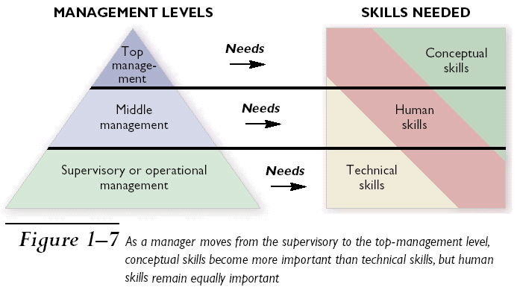
Levels of Management

Slide 17
Levels of Management
First-line Managers: have direct responsibility for
producing goods or services Foreman, supervisors,
clerical supervisors
Middle Managers:
Coordinate employee activities
Determine which goods or services to provide
Decide how to market goods or services to customers
Assistant Manager, Manager (Section Head)
Top Managers:
Provide the overall direction of an organization
Chief Executive Officer, President, Vice President

Slide 18
Top Managers
Responsible for providing the overall direction of an organization
Develop goals and strategies for entire organization
Spend most of their time planning and leading
Communicate with key stakeholders—stockholders, unions, governmental agencies, etc., company policies
Use of multicultural and strategic action competencies to lead firm is crucial

Slide 19
Technical Skills: A persons’ knowledge and ability to
make effective use of any process or technique constitutes
his technical skills.
For eg: Engineer, accountant, data entry operator,
lawyer, doctor etc.
Human Skills: An individuals’ ability to cooperate with
other members of the organization and work effectively
in teams.
For eg: Interpersonal relationships, solving people’s
problem and acceptance of other employees.
Conceptual Skills: Ability of an individual to analyze
complex situations and to rationally process and interpret
available information.
For eg: Idea generation and analytical process of information.

Slide 20
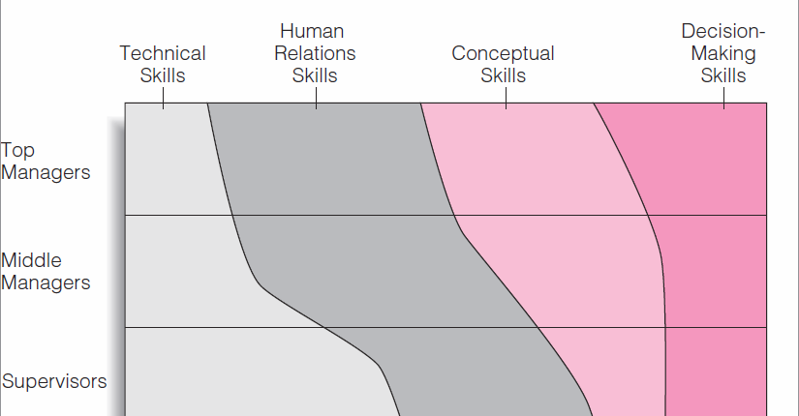

Slide 21
MANAGEMENT AND ADMINISTRATION
Administration:
Determines the objectives.
Lay down policies & principles.
Prepares the framework under which one has to work.
Provides direction, guidance & leadership.
Management:
Planning the work as per objectives.
Executes the policies & procedure.
Supervises & controls the execution of assigned work.
Co-ordinates all the resources & activities.

Slide 22
MANAGEMENT AND ADMINISTRATION
Administration is a broader than Management:
- Administration is largely determinative while management
is essentially executive.
- Administrators think while managers act.
Management is broader than Administration:
- Management is rule-making, rule-enforcing,
all-encompassing body while administration implements
and carries out the policies.
Management and administration are identical:
- it is a futile exercise to distinguish between the two
as both as expected to do the thinking and doing
functions simultaneously.

Slide 23
Development of Management Thought
Early Classical Approaches:
Scientific Mgt.
Administrative Mgt.
Bureaucracy.
2. Modern Approaches:
Behavioral Approach
Quantitative Approach
System Approach
contingency Approach/Situational Approach

Slide 24
Cont’d
Functional Organization: Specialization
Deferential Price-rate plan:
Production α Incentive.
More work, more pay.
Standardization of tools & equipments:
- Tool room in every workshop to ensure supply of
uniform tools to all workers.
Scientific recruitment & training:
- scientific selection & development of worker.
(to do higher, more interesting, more profitable class of Work)

Slide 25
ADMINISTRATIVE MANAGEMENT Henry Fayol-Father of administrative mgt.
Division of work
- Elemental job.
Authority & Responsibility
Authority : Right to give orders and power to extract obedience.
Responsibility: Accountability for ones an action.
Unity of Command:
- Instructions through one supervisor only.
Unity of Direction:
- Towards the common goal/ organizational goal.
Discipline:
- Good supervision at all levels.
- Clear agreements between employee & employer.
- Judicious application of penalties

Slide 26
Centralization: Everything that goes to increase the importance
of subordinate’s role is decentralization, every thing which
goes to reduce is centralization.
Scalar Chain: The hierarchy of authority from superiors to
subordinates.
Order: Right place for everything and every man
Equity: Equality of fair treatment.
Initiative: Freedom to think out and execute a plan.
Esprit de Corps: Union is strength, team spirit.

Slide 27
Bureaucracy Max Weber - Father of Bureaucracy
Leader Orianted:
No delegations of management functions, All employees
serves as loyal of subjects of a leader.
Traditional Oriented:
Managerial positions or headed down from generation to generation
Bureaucratic:
- Delegation of mgt. responsibility is based on the person’s
demonstrated ability to hold the position.

Slide 28
System Approach :
Diagram
contingency Approach/Situational Approach:
There is no one best way of doing things under all conditions in all organizations.
The techniques and methods that are highly effective in one situation may be failure in similar situation in other area
Ex:OS, Degree of Decentralization, Motivational and Leadership approaches, Establishing the communication system, Resolving conflicts and training the employees etc.

Slide 29
Planning

Slide 30
MEANING
According to Koontz and O’Donnel “Planning is deciding in advance what to do, how to do it, when to do it and who is to do it. It bridges the gap from where we are and to where we want to go. It is in essence the exercise of foresight”.
According to M.S. Hardly “Planning is deciding in advance what is to be done. It involves the selection of objectives, policies, procedures and programmes from among alternatives.

Slide 31
Nature of Planning
Planning: A Rational Approach
- Rationalist denotes a manager chooses appropriate means for achieving the stated objectives rational approach fills the gap between the current status and future status.
- The difference between two time periods T1 and T2 may be as long as 5 years or as short as one year.

Slide 32
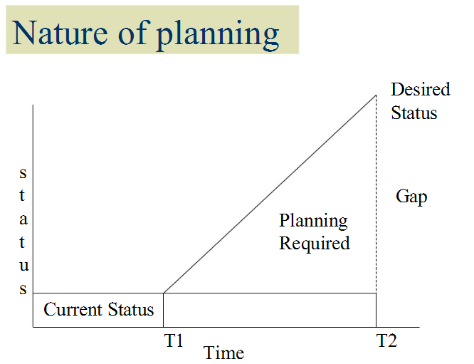

Slide 33
Planning: An Open System Approach
Open system approach indicates that the gap between current and desired status and the action required to bridge this gap is influenced by a variety of environmental economic, legal, political, technological, socio-cultural and competitive factors.
These factors are dynamic and change with time.

Slide 36
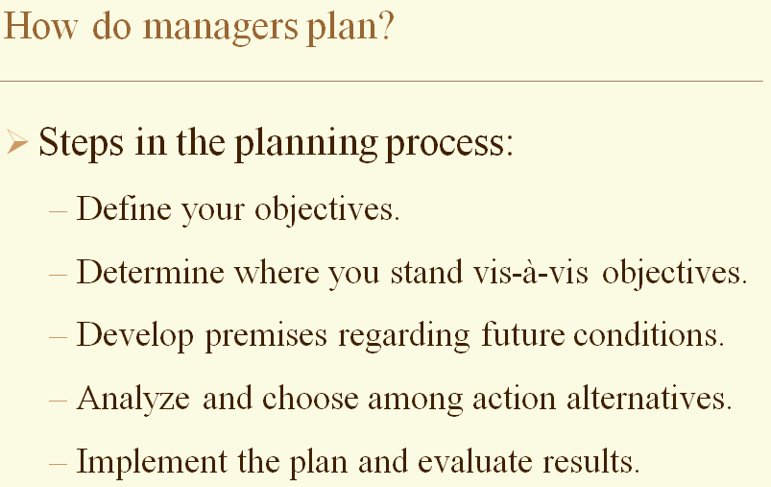

Slide 38
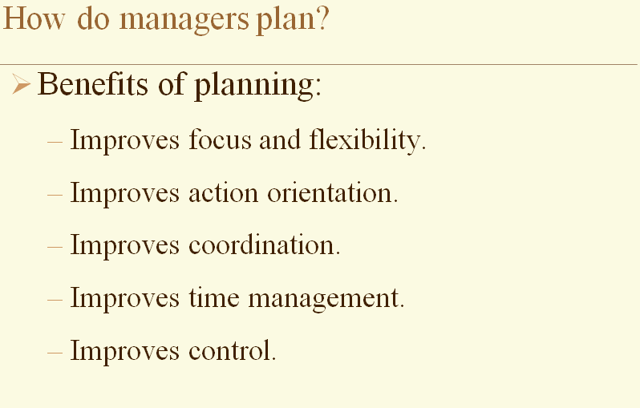

Slide 45
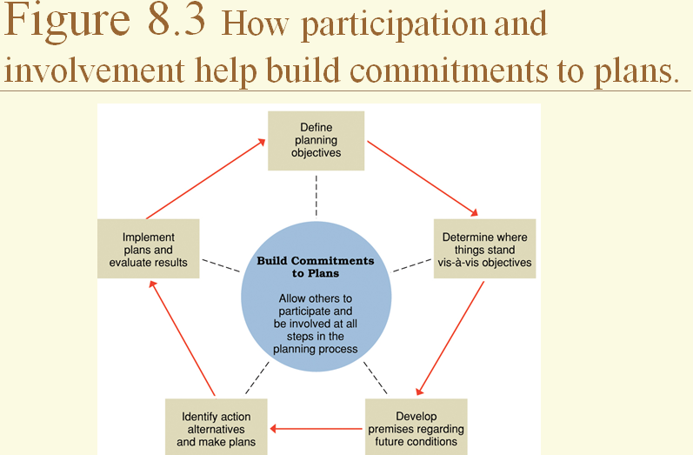

Slide 47
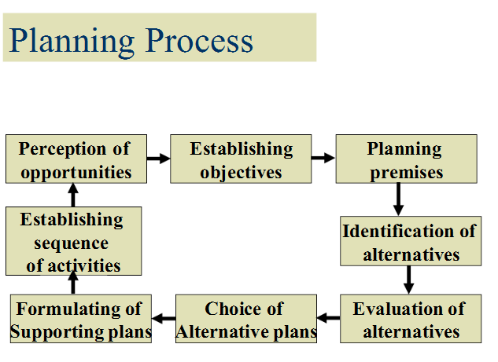

Slide 52
organization

Slide 53
Organization – a group of people working together in a structured & coordinated way to achieve goals.
Management is a set of activities directed at an organization’s resources for achieving goals effectively & efficiently.

Slide 54
Definitions
Organization involves the grouping of activities necessary to
accomplish goal and plans, Assignments of these activities to
appropriate departments and positions for authority,
designation and Co-ordination.
-Koontz &O'Donnell
An organization is rational co-ordination of the activities
Or roles of a number of people for the achievement of
Some common explicit purpose or goal, through division
Of labor and function and through a hierarchy of
Authority and responsibility.
-E. H. Schien

Slide 55
Nature or Characteristics of Organization
1. Organization is made of group of people:
When a group of people come together to work for a common cause.
2. Organizations aim at common goals and not personal goals:
It is the common goal of the organization which provides the basis for co-operation.
3.Organization have both vertical and horizontal relationship:
It creates co-operative relationships between different
departments as well as between superiors and subordinates.

Slide 56
4. Organization establishes authority or chain of command:
- Higher level to Lower level
5. Dynamics of Organization:
- On going process(continuous)
- Exists interaction based on sentiments, attitude and behaviour of individuals and groups.

Slide 57
Principles of Organization
1. Principle of unity of objectives:
- Clearly defined.
- Common objective/goal.
2.Principle of Authority and responsibility:
- Authority : Right to give orders and power to extract obedience.
- Responsibility: Accountability for ones an action.
3.Principle of span of control:
The number of persons who directly report to an executive is called SOC.

Slide 58
4.Principle of Dividing and Grouping of Activities:
- It lead to specialization like product, process, and labour specialization etc.,
5. Principle of Delegation:
- It means authorizing somebody to do the work.
Own decision.
6.Principle of co-ordination:
- Co-operation among group of workers for the achievement of predefined goals.

Slide 59
7.Principle of Communication:
- Top to Bottom or Bottom Up
8.Principle of Line and Staff relationship:
Line: Directly contribute to the profit of the organization
Ex: Production Activity, Sales Activities.
Staff: Give guidance to the Line members
Ex: R & D heads.
9.Principle of Simplicity:
- OS must be with a minimum number of levels.
10. Principle of Flexibility:
- Adoptability to change in order to meet changing demands.

Slide 60
Formal And Informal Organ..
A formal organization is one which has a system of well defined position, authority, responsibility, policies, principles etc.,
Formal organization are governed by rules and regulations for its proper functioning.
- Informal organization are those formed by people spontaneously on the basis of friendship or some common need and are not based on rules, regulation and procedures.

Slide 62
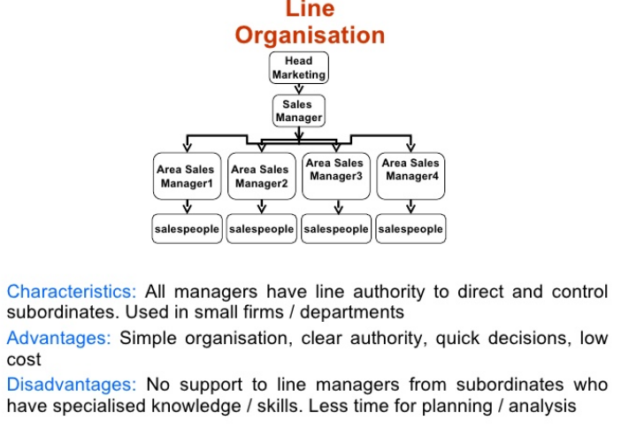

Slide 63
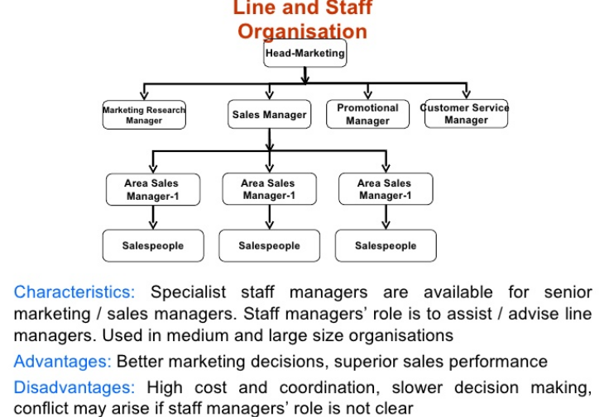

Slide 64
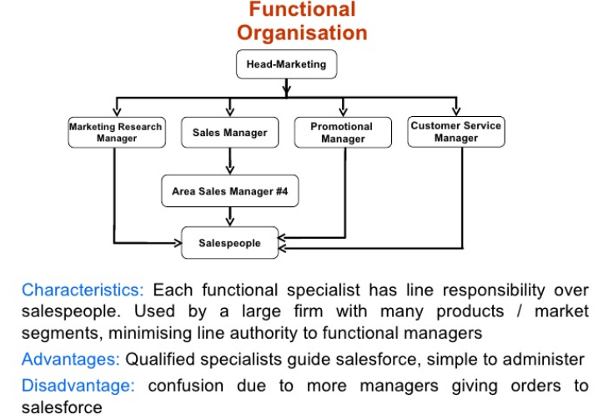

Slide 65
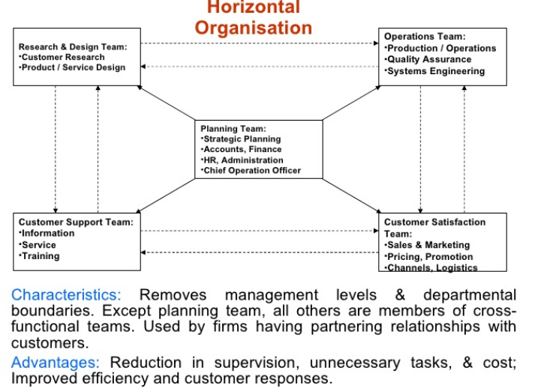

Slide 66
Authority – delegation from top to lower levels of management & the right of managers to direct others & take action of their position.
Responsibility – obligation to perform an assigned activity or see that someone else performs it.

Slide 67
Authority
Formal authority – exists because of position in the organization.
Positional authority – derived from the position or office.
Acceptance authority – based on employee’s acceptance of that authority.
Authority of competence – based on a manager’s competence or expertise.

Slide 68
Management By Exception
According to F. W. Taylor only unusual and exceptional
deviation in the daily routines of the factory should be
brought to the management .
All normal work going as per schedule and as per plans
should not be brought to the Managers attention since
no corrective action or follow up action is necessary.

Slide 71
Staffing Steps
Human Resources Planning
designed to ensure an organization’s labor requirements are continuously met.
Recruitment & Selection
concerned with developing, evaluating, & choosing a pool of job applicants.
Orientation, Training, & Development
acquaints newcomers with organization & its goals & policies & informs them of their responsibilities.

Slide 72
Staffing Cont’d Steps
Performance Appraisal
compares an individual’s performance with established standards for the job.
Compensation
encompasses all activities concerned with administration of the wage, salary, and benefits program.

Slide 73
Exh. 1.2: Staffing Quantity
Projected Staffing Requirements
Overstaffed
Fully Staffed
Understaffed
Compare
Projected Staffing Availabilities

Slide 74
Exh. 1.3: Person/Job Match
Job
Requirements
Rewards
Attraction
Performance
Retention
Attendance
Satisfaction
Other
HR Outcomes
Match
Impact
Person
KSAOs
Motivation

Slide 75
Exh. 1.4: Person/Organization Match
Organization
Values
New Job
Duties
Job
Requirements
Rewards
Attraction
Performance
Retention
Attendance
Satisfaction
Other
HR Outcomes
Multiple
Jobs
Future
Jobs
Match
Impact
Person
KSAOs
Motivation

Slide 76
Exh. 1.5: Staffing System Components
Applicant
(Person)
Organization
(Job)
Recruitment
(identification and attraction)
Selection
(assessment and evaluation)
Employment
(decision making and final match)

Slide 77
Recruitment
The process of searching for prospective employees and stimulating
them to apply jobs in the organization.
Sources :
Internal- promotions, transfer etc.,
External –
Former Employees
Recommendations- Friends or relatives.
Employment Exchange
Campus interview
Walk-in
Etc.,

Slide 78
Selection A process of picking out a few suitable persons from a large number
Steps:
Receipt of Job Applications:
First step
They gives details of family background, education,
age, professional experience, training received,
interested in extra curricular activities, hobbies,
previous salary drawn, salary expected and reference.
2. Preliminary Interview:
3. Employment Test:
Proficiency Test, 2. Aptitude Test, 3.Personality Test.

Slide 79
Cont’d
4. Group Discussion:
Candidates are assembled in small groups and
a general topic of current interest is thrown open
for discussion.
5. Final Interview:
Main aim is to evaluate the candidate’s qualifications
for a particular job.
6. Checking References:
7. Medical Examination:
8. Placement:

Slide 80
INTRODUCTION
Directing means issuing orders, leading and motivating subordinates as they go about executing orders.
Definition:
Directing is the interpersonal aspect of managing by which subordinates are lead to understand and contribute effectively to the attainment of enterprise objectives. Koontz O’ Donnel
Directing consists of the process and techniques utilized in issuing instructions and making certain that operations are carried out as originally planned. Haimann

Slide 81
LEADERSHIP AND LEADERSHIP STYLES
The success of a business concern depends upon the ability of its leadership. For example Microsoft, Reliance, Mittal Steels would not have attained their present success but for the able leadership of Bill Gates, Dheerubai ambani and Lakshmi Mittal.
“leadership is generally defined as influence, the art of process of influencing people so that they will strive willingly towards the achievement of group goals”. - Koontz and O’Donnel,

Slide 82
Different types
Autocratic :
an autocratic leader assumes all power and decision making in him self and exercises complete control over the subordinated.
this leadership can be applied in following situation:
When subordinates are incompetent and inexperienced.
when leader prefers to be active and domonent in decision making
when the company endorses fear and punishment as disciplinary technique.

Slide 83
Democratic/ participative :
decisions are taken by the leader in consultation with subordinates and with their participation in the decision making process.
this leadership can be applied in following situation:
When subordinates are competent and experinced
The leader prefers participative decision – making process.
The leader wishes to develop analytical and self – control abilities in his subordinates.

Slide 84
Laissez – faire ( allowing to do)
a manager who adopts this style, completely gives up his leadership role.
The subordinates group is allowed to make decisions. And it is left to the members of the group to do as they like.
The group members enjoy full freedom in goal setting and acting on it.

Slide 85
Cntd…..
This leadership can be applied in following situation:
When the leader is interested in delegating decision making fully
subordinates are well trained
organization goals have been communicated well.

Slide 86
PRINCIPLES
Harmony of objectives
Unity of direction
Direct supervision
Effective communication
Follow through

Slide 87
Motivation
Motivation is inspiring the subordinates to contribute with zeal and enthusiasm towards organizational Goals.
“Channelizing a person’s inner drive” so that he wants to accomplish the goals of the organization.

Slide 88
MOTIVATION THEORIES
Maslow’s need hierarchy theory.
Herzberg’s two factor theory.
McGregor’s Theory X and theory Y.
Chris Argyrious Immaturity and maturity theory.
etc….

Slide 89
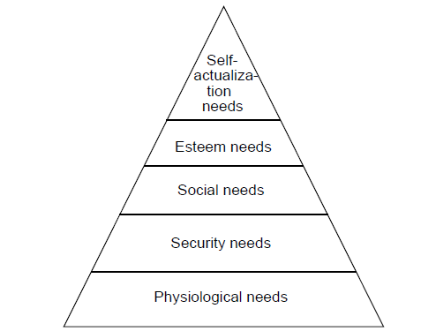
MASLOW’S HIERARCHY OF NEEDS

Slide 90
MASLOW’S NEED HIERARCHY THEORY
Physiological needs
(basic needs like food , shelter , clothing , water , sex).
Security / safety needs
(protection from physical , emotional and economical harm. i.e. job security , health and insurance programme , retirement plan , free from mental disturbances etc).

Slide 91
social needs
( love , affection , belongingness, social acceptance , friendship etc)
4. Esteem needs
( self respect , status, recognition , responsibility, attention , achievement , prestige etc.)
5. Self actualization
( self advancement, self fulfillment , self development and self realization )

Slide 92
HERTZBERG’S TWO FACTORS THEORY
Hygiene factors: Their existence does not motivate but their absence result dis-satisfaction. Hertzberg called these factors as hygiene or maintenance factors.
Motivators: Feeling which produces feelings of achievement, recognition in jobs can be called Motivator.

Slide 93
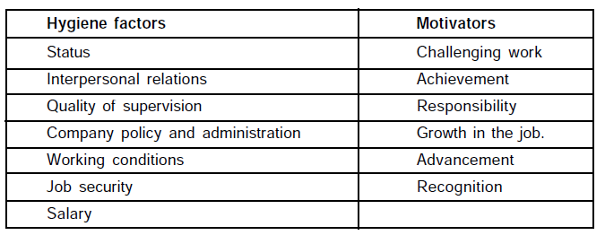

Slide 94
MCCLELLAND’S NEED THEORY

Slide 95
COMMUNICATION
“The process of exchange of information, ideas and opinions which bring about integration of interests aims and efforts among the members of a group organized for achievement of predetermined goals.
“Communication is the sum of all the things a person does when he wants to create understanding in the mind of another” - Allen

Slide 97
Importance of Communication
1. Communication is fundamental to accomplish work:
Reading, Writing, Speaking or Listening.
2. Communication facilities planning:

Slide 99
<number>
What is Entrepreneurship?
An Entrepreneur is a person who organizes and manages a business undertaking, assuming the risk for the sake of profit. Any person (any age) who starts and operates a business is an entrepreneur.

Slide 100
<number>
Who is an entrepreneur?
Person conducting own business (Webster)
Person who sets up business deals in order to make profits (Collins Cobuild)
Organizer of an economic venture, one who owns, organizes, manages, and assumes the risks of the business (Chandrashekhar)

Slide 101
MEANING
“An entrepreneur is one who always search for change, responds to it and exploits it as an opportunity” - Peter Drucker
“An entrepreneur in any given economy is an individual who introduces something new in the economy” - Joseph S.
“An entrepreneur is a social parasite”
- Karl Marx.

Slide 102
CONCEPT OF “ENTREPRENEURSHIP” Entrepreneur & Entrepreneurship are essentially the same
“Entrepreneurship is the process of creating something new and assuming the accompanying risks and rewards.”
- Robert Hisrich
“ Entrepreneurship is the purposeful activity of an individual or a group of associated individuals, undertaken to initiate, maintain and realize profit by producing or distributing economic goods and services.” - A. H. Cole.

Slide 103
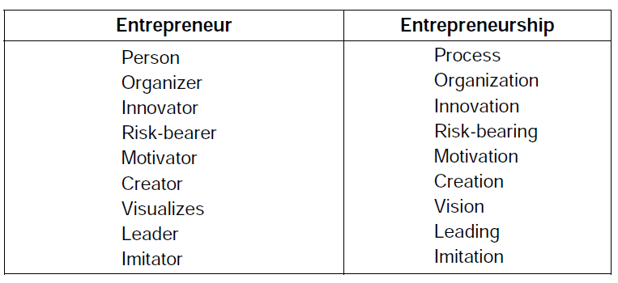

Slide 104
EVALUATION OF THE CONCEPT OF “ENTREPRENEUR” It is derived from the French word ’entreprendre’ which mean ‘to undertake’
Some stages of the evolution of the concept ‘entrepreneur’ are as follow.
Middle Ages: Actor or person in charge of large scale production projects.
16th Century: People who organized and led military expedition in France .
17th Century: Person bearing the risk of either profit or loss in a fixed-price
contract with the government.
18th Century: An entrepreneur as a person is risk-taking and different from the person who supplies capital.
19th Century: An entrepreneur is distinct from both a financier as well as a
manager. A financier receives interest for funds supplied
while a manager receives salary for responsibilities discharged.
20th Century: An entrepreneur came to be known as an innovator and risk- taker during the middle of 20th century. Late several other definitions were coined by famous people, as mentioned in the previous pages.

Slide 105
FUNCTION OF AN ENTREPRENEUR
Entrepreneur as an Innovator:
- Joseph A SchumPeter in 1934 assigned a crucial role of
‘innovation’ to the entrepreneur.
- He considered economic development as a dynamic
change brought by entrepreneur by instituting new
combinations of factors of production, i.e. innovations.
(a) Introduction of new product in the market.
(b) Use of new method of production, which is not yet tested.
(c) Opening of new market.
(d) Discovery of new source of raw materials.
(e) Bringing out of new form of organisation.

Slide 106
FUNCTION OF AN ENTREPRENEUR
(ii) Entrepreneur as a Risk-taker:
Richard Cantilon defined entrepreneur as an agent who buys factors as production at certain prices in order to combine them into a product with a view to selling it at uncertain prices in future.
(iii) Entrepreneur as an organizer:
“an entrepreneur is one who combines the land of one, the labour of another and capital of yet another, and thus produces a product. By selling the product in the market, he pays interest on capital, rent on land and wages to laborers and what remains is his/her profit”.

Slide 107
Characteristics of an entrepreneur Effective communicator Negotiating skills Total communication Risk taker Emotional stability Problem solver Relations human and public Energetic Networking ability Excellence in economics Understands how to administer and organise Real inventor

Slide 108
Distinction between Entrepreneur and manager

Slide 109
TYPES OF ENTREPRENEURS
According to stages of economic development >Innovative >Imitative >Fabian >Drone According to the type of business >Business >Trading > Industrial >Corporate >Agricultural >Retail >Service

Slide 110
Cont’d
According to use of technology
>Technical
>Non-technical
>Professional
>High tech
>Low tech
According to area
>urban
>Rural
According to gender
>men
>women

Slide 111
Innovative entrepreneur
The opportunities for introduction of new ideas, new technology, discovering of new markets and creating new organizations.

Slide 112
2. Adoptive or imitative entrepreneur:
Instead of innovation, may just adopt the technology and methods innovated by others.

Slide 113
3. Fabian entrepreneurs:
Fabian entrepreneurs are characterized by great caution and skepticism, in experimenting any change in their enterprises.

Slide 114
4. Drone entrepreneurs:
Such entrepreneurs are conservative or orthodox in outlook. They always feel comfortable with their old fashioned technology of production even though technologies have changed.
They never like to get rid of their traditional business, traditional machineries and traditional system of business even at the cost of reduced returns.

Slide 115
INTRAPRENEURS
Every organization faces the problem of sudden resignation of their top executives.
To overcome such situations, Gifford Pinchot-III, an American guru, suggested in 1985 that large corporations should create smaller systems within the organization and allow certain executives to operate like entrepreneurs.

Slide 116
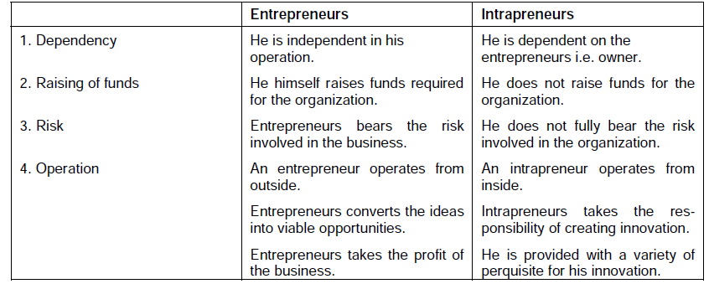

Slide 117
STAGES IN ENTREPRENURIAL PROCESS
1. Identification of the opportunity
The opportunity is identified by …
Internal source
His own idea
External sources -
1.Consumer and business associates
2. Member of distribution system
3. Independent technical organizations
4. Consultants
5. Consumers( End users)
6. R &D Centers.

Slide 118
2. Evaluation of the opportunity
It allows the entrepreneur to assess whether the specific product or service provides sufficient return on investment.
It involves – length of the opportunity, its real and perceived value, risks and returns, its fit with personal skills, SWOT and goals of the enterprise,. etc.
3. Development of business plan
It includes:
> Title of the project
> Description of business and industry
> Technology plan
> Financial plan
> Organizational plan
> Production and operation plan
> Marketing and distribution plan
> Summary of plans.

Slide 119
4. Determination and organizing the recourses
(the assessment of present resources)
The risk involved with insufficient and incorrect resources should be calculated.
Organizing the required resources in at the appropriate time is another important aspect of the entrepreneurial process.

Slide 120
5.Creation and actual management of the enterprise:
(The implementation of the BP)
The operational problems of the growing enterprise must be examined. This calls for the management with all the functions like planning , organizing , staffing, directing and controlling.

Slide 121
Role of the Entrepreneur
Important role in producing competitive products, processes, and services.
Generation of new employment.
Local and regional economic development.
Improved allocation of resources and transfer of technologies.
It encourages effective resources mobilization of capital and skill which might otherwise remain unutilized and idle.

Slide 122
ENTREPRENEURSHIP IN INDIA
Pre-Christian Era Metal Handicrafts
Post Christian Era Kharkhanas, Guilds
Modern Era(BEIC) Ship & Gun Powder
- L. Nushirwan & M. Dhanjee
4. 1847 Textile Industry
- Ranchod Lal Chotalal
5. 1911 1st Steel Industry
- J. TATA
6. 1919 Jute Mill
- Birla Family

Slide 123
7. Swadeshi Campaign by M. Gandhi
8. Nehru Govt. help Indian Entrepreneur
9. 1991 onwards…..
- Azim Premjee
- N. R. Murthy
- Subhasha Chandra etc.,

Slide 124
BARRIERS TO ENTREPRENEURSHIP A large number of entrepreneurs particularly in the small enterprises fail due to several problems and barriers. The greatest barrier to entrepreneurship is the failure of success.
Karl. H. Vesper has identified the following entrepreneurship barriers:
1. Lack of a viable concept
2. Lack of market knowledge
3. Lack of technical skills
4. Lack of seed capital
5. Lack of business know how
6. Complacency—lack of motivation
7. Social stigma
8. Time presence and distractions
9. Inability to invest in R & D and Innovate
10. Inhibitions due to patents

Slide 126
INTRODUCTION
Entrepreneurs who wish to start a business or industrial units require various resources and facility apart from appropriate information related to their business.
Recognizing the need to help budding entrepreneurs, both central and state govt. have started and initiated varies Agencies, Institutes, Banks, Boards etc, through out the country.

Slide 127
D I C A Single Window Agency
Meaning:
The District Industries Centres (DIC’s) programme was started in 1978 in all district of each state.
There are about 400 DIC’s in India.
Nature of Support:
Information & consultancy services, Industrial inputs.

Slide 128
Objectives:
To effectively promote cottage industry and SSI’s in rural areas and small towns.
To act as single window agency to help the entrepreneurs with all the information under one roof.
To serve as an integrated administrative frame work at the district level for industrial development.
Functions:
Surveys: The survey provides the basis for advising budding entrepreneurs.
- Raw material, Man power, Infrastructure, demand for a product etc.,

Slide 129
(ii) Action Plan: To prepare action plan to implement the schemes effectively already identified.
(iii) Appraisal: To appraise various investment proposals received from entrepreneurs.
(iv) Guidance: To guide entrepreneur in selecting machinery and equipment.
(v) Marketing: To assist entrepreneur in marketing their products and access the possibility of export promotion.
(vi) R & D: To link R & D institutes with entrepreneurial activities for product innovation.
(vii) Training: To conduct training programmes.

Slide 130
S I S I
MEANING –SMALL INDUSTRIES SERVICE INSTITUTE
- There are 58 SISIs all over the country including in each state capital.
NATURE OF SUPPORT:
- Entrepreneurship development, consultancy and
training.
OBJECTIVES:
- To provide consultancy and training to small
entrepreneurs.
- To serve as an interface between state and central govt.
- To initiate entrepreneurial promotion programmes.

Slide 131
Functions
To render technical support services.
To conduct entrepreneurship technical programmes.
To collect trade and market information and share it with entrepreneurs.
To provide consultancy services.
To provide training in various activities.

Slide 132
N S I C
Meaning: National Small Industries Corporation, Ltd.
Set by the central govt. in 1955
Nature of support :
- Wide ranging industrial inputs.
Objectives:
(i) To promote, aid and faster the growth of SSIs in the country with a focus on commercial activities.
(ii) To enable SSIs to gain competitive advantage and to contribute effectively to the development of the country.

Slide 133
To evolve special/schemes to meet the needs of handicapped ,SC/ST entrepreneurs.
Functions:
- To provide machinery on a hire-purchase scheme to SSIs.
To procure govt. orders to small scale units.
To develop small-scale units as ancillaries to large industries.
To undertake construction of industrial estates.
To help exporting products of SSIs.
To develop prototypes of machines and equipments
and pass-on the ‘know-how’ to SSIs.
To set up SSIs in other developing countries.

Slide 134
S I D B I (disbursed more than 50,000 crores as financial assistance
Meaning: Small Industries Development Bank of India. Set Up in 1990. head office is in Lucknow.
Nature of support:
Financial services and other support services.
Objectives:
- To promote, finance and develop small scale sectors in India. - To contribute the functions of other institutes engaged in similar activities.
- To finance industrial infrastructure projects.

Slide 135
Functions
To provide finance assistance to
- new projects
- expansion/diversification of projects
- modernization of projects
To initiate steps for technological upgradation and modernization of existing units.
To promote rural industrialization.
To provide channels for marketing SSI products in India and abroad.
To foster HRD to suit SSI sector needs.
To disseminate appropriate information to budding and existing end.

Slide 136
K S F C
MEANING :
Karnataka state financial corporation.
Established in 1951 through a state financial corporation .
OBJECTIVES:
To cater to financial requirements to SSIs.
To extend medium and long term credits to units which fall outside the purview of industrial financial corporation and public sector banks.

Slide 137
FUNCTIONS
To provide long term finance to small and medium sized industrial units organized on different ownerships( proprietorship, partnership, cooperative, public or private company concerns).
To provide finance to service oriented enterprise
(Hotels, nursing homes, hospitals , car rental agencies, tourism etc).
To take over sick SSI units and auction them to entrepreneurs willing to rebuild.

Slide 138
T E C S O K
Meaning: Technical consultancy services of Karnataka.
It was established in 1976 by govt of karnataka.
Nature of support :
Multi disciplinary technical industrial and management consultancy.
Objectives:
-To provide reliable consultancy support for entrepreneurs to start up self employment ventures in karnataka.
-To provide consultancy services to various departments and agencies of state and central govt.

Slide 139
FUNCTIONS
To identify investment opportunities which are location specific.
To assist entrepreneurs in obtaining statutory and procedural clearances.
To carry out feasibility studies.
To assist preparation project reports as per investment norms and financial norms.
To carry out market survey.
To assist project implementation.
To help in recognizing and rebuilding employees.
To provide consultancy in valuation of assets , man power planning and budgetary control system.

Slide 140
K I A D B
Meaning: KARANATAKA INDUSTRIAL AREA DEVELOPMENT BOARD.
- It is established in 1966 by govt of Karnataka.
Objectives:
-To establish industrial areas and to promote rapid and orderly establishment of industries in the state of karnataka.
To provide infrastructural facilities to SSIs.
To assist in implementation of govt. policies.
To function on ‘no profit-no loss’ basis.

Slide 141
FUNCTIONS
To acquire land for industrial activities at notified/identified locations. With all infrastructural facilities like road , man power , water supply.
To quire land in-favor of single unit.
To provide infrastructure facilities to single unit complexes industrial area.
To maintain infrastructure facilities.

Slide 142
K S S I D C
Meaning : karnataka state small industries development corporation Ltd.
- It is established in the year 1960 by govt. of Karnataka.
Nature Of Support :
- infrastructure and industrial inputs.
Objectives :
- To assist SSIs in the procurement of raw materials.
- To take up any activity aimed at rapid development of small scale industries.

Slide 143
FUNCTIONS
To establish and manage industrial estates.
To procure and distribute scare and rare raw materials to various SSIs.
To provide assistance towards marketing of products form various SSIs.
To organize national and international level exhibition and to facilitate exchange of information .
To supply machinery under hire –purchase scheme.

Slide 144
To provide guidance to SSI entrepreneurs.
To provide technical library facilities to help entrepreneurs in their work.
To provide laboratory facilities in coordination with ISI( Indian Standard Institute).

Slide 145
K S I M C
Meaning : KARNATAKA SMALL INDUSTRIES MARKETING CORPORATION.
- It is established in the year 2001.
Objectives:
-To extend marketing support and assistance
-To procure govt. needs from SSI’s thoroughly purchase and price preference.

Slide 146
FUNCTIONS
- To improve quality of products.
- To improve production / manufacturing processes.
- To help in reduction of prices.
- Augment (make greater)exports.

Slide 148
INTRODUCTION
A project is nothing but a scheme or a design or a proposal of something intended or devised to be achieved.
A project is a whole complex of activities involved in using resources to gain benefits.
- Gillinger
A project is an organized unit dedicated to the attainment of a goal and the successful completion of project on time, within budget, in conformance with predetermined program specification. - EOM

Slide 149
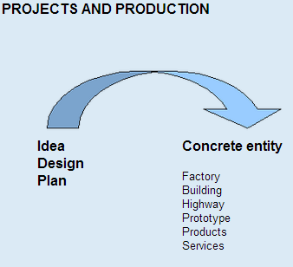

Slide 150
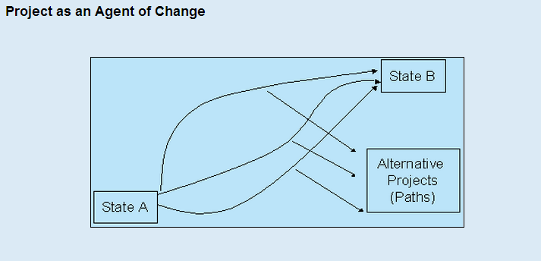

Slide 151
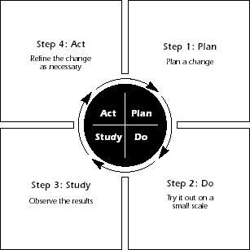
Roadmap also follows the PDSA cycle:

Slide 152
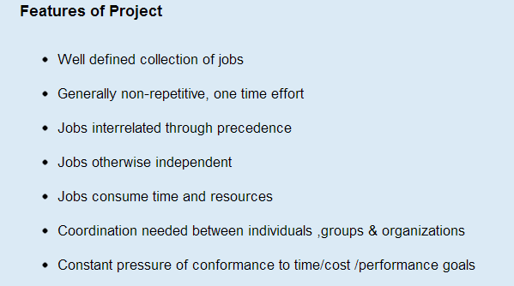

Slide 154
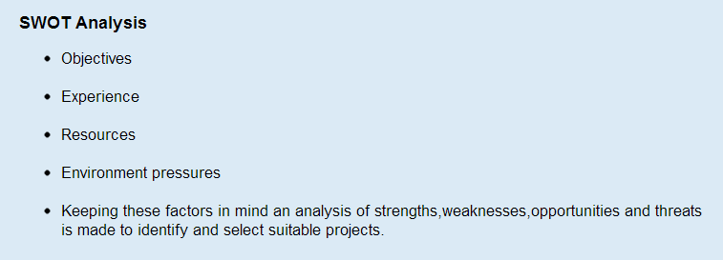

Slide 155
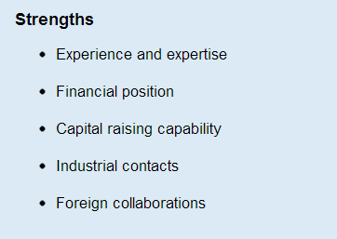

Slide 156
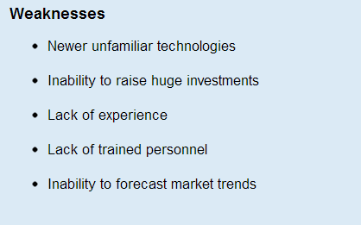

Slide 157
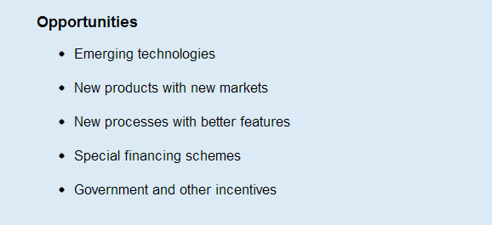

Slide 158
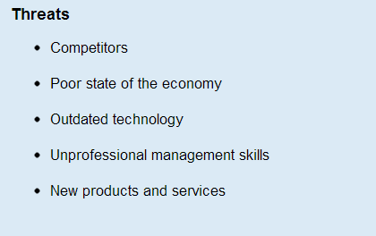

Slide 159
Project Report – Need & Significance (Feasibility Report)
A PR is a road map to reach the destination which is determined by the entrepreneur.
It describes direction of business…..
It also enables an entrepreneur to know whether he is preceding in the right direction(Planning & Implementation).
Good PR is needed to attract investors such as Banks, Financial Institutes, Venture-capitalists, and lenders.

Slide 160
Cont’d
With a PR, obtaining various licenses & clearances is virtually possible.
A well prepared PR can serve as a model and may inspire many more projects and reports.

Slide 161
CONTENTS OF A PROJECT REPORT
A good project report should contain the following.
(1) General information: Information on product profile and product details.
(2) Promoter: His/her educational qualification, work experience, project related experience.
(3) Location: exact location of the project, lease or freehold, location advantages.
(4) Land and building: land area, construction area, type of construction, cost of construction, detailed plan and estimate along with plant layout.

Slide 162
Cont’d
(5) Plant and machinery: Details of machinery required, capacity, suppliers, cost, various alternatives available, cost of miscellaneous assets.
(6) Production process: Description of production process, process chart, technical know how, technology alternatives available, production programme.
(7) Utilities: Water, power, steam, compressed air requirements, cost estimates sources of utilities.
(8) Transport and communication: Mode, possibility of getting costs.

Slide 163
(9) Raw material: List of raw material required by quality and quantity, sources of procurement, cost of raw material, tie-up arrangements, if any for procurement of raw material, alternative raw material, if any.
(10) Man power: Man power requirement by skilled and semi-skilled, sources of manpower supply, cost of procurement, requirement for training and its cost.
(11) Products: Product mix, estimated sales distribution channels, competitions and their capacities, product standard, input-output ratio, product substitute.

Slide 164
Cont’d
(12) Market: End-users of product, distribution of market as local, national, international, trade practices, sales promotion devices, proposed market research.
(13) Requirement of working capital: Working capital required, sources of working capital, need for collateral security, nature and extent of credit facilities offered and available.

Slide 165
Cont’d
(14) Requirement of funds: Break-up project cost in terms of costs of land, building machinery, miscellaneous assets, preliminary expenses, contingencies and margin money for working capital, arrangements for meeting the cost of setting up of the project.
(15) Cost of production and profitability of first ten years.
(16) Break-even analysis.
(17) Schedule of implementation.

Slide 166
FORMULATION OF PROJECT REPORT
A PF is a systematic development of a project idea so as to help arrive at an investment decision.

Slide 167
Sequential stages:
(1) General information
(2) Project description
(3) Market potential
(4) Capital costs and sources of finance
(5) Assessment of working capital requirements
(6) Other financial aspects
(7) Economical and social variables
(8) Project implementation

Slide 168
(1) General Information
Bio-data of promoter: Name and address, qualifications, experience and other
Industry profile: Past performance; present status, its organization, its problems etc.
Product details: Product utility, product range, product design, etc.

Slide 169
(2) Project Description
(a) Raw material:
(b) Skilled labour:
(c) Utilities:
(i) Power, (ii) Fuel, (iii) Water.
(d) Pollution control
(e) Communication and transportation facility
(f) Production process
(g) Machinery and equipment
(h) Capacity of the plant
Technology selected
(j) Other common facilities
(k) Research and development:

Slide 170
(3) Market Potential
(a) Demand and supply position,(b) Expected price,
(c) Marketing strategy, (d) After sales service.
(4) Capital Costs and Sources of Finance
(5) Assessment of Working Capital
(6) Other Financial Aspects:
The break-even point indicates at what level of output the enterprise will break even.
(7) Economical and Social Variables
(i) Employment Generation, (ii) Import Substitution
(iii) Ancillaration, (iv) Exports
(v) Local Resource Utilization (vi) Development of the Area
(8) Project Implementation

Slide 171
PLANNING COMMISSION GUIDELINES
General information:
The priority of the industry, increase in production, role of the public sector, allocation of investment of funds, choice of technique, etc. This should contain information about the enterprise submitting the feasibility report.

Slide 172
2. Preliminary analysis of alternatives:
- Current data available on the gap between
demand & supply for the product to be
produced.
- Data on the production capacity that would be
made available.
- A complete list of existing plants in the
industries and their capacities.
- Information on the location of the plant.

Slide 173
3. Project description:
Population, water, land, air, effects arising out of the project’s pollution, other environmental destruction, etc.
4. Marketing plan:
- Data on the market plan.
- Supply and demand data.
- Forecasting technique.
- Price sensitivity of the product.
- And analysis of past trends in prices.

Slide 174
5. Capital requirements and cost:
6. Operating requirements and costs:
Operating costs relate to cost of raw, materials and intermediaries, fuel, utilities, labour, repair and maintenance, selling expenses and other expenses.
7. Financial Analysis: Foreign exchange requirements should be cleared by the Department of Economic Affairs. The feasibility report should take into account income tax rebates for priority industries, incentives for backward areas, accelerated depreciation, etc.
8.Economic Analysis: adjustment involves a correction in input and cost, to reflect the true value of foreign exchange, labour and capital.

Slide 175
ERRORS IN PROJECT REPORT
Product Selection
Capacity utilization estimates
Market study
Technology Selection
Selection of location.

Slide 176
PROJECT APPRAISAL
Project appraisal means the assessment of project in terms of its economic, social and financial liability.
Appraisal of a proposed project is called ‘ex-ante analysis’ while appraisal of a executed project is called ‘post-ante analysis’.

Slide 177
MARKET APPRAISAL
A market appraisal is carried out to assess the market potential of a project.
● Nature of the Market.
● Cost of Production
● Selling price and profit
● Demand
● Market share
● Target market

Slide 178
TECHNICAL ANALYSIS
It is carried out to assess the technical details of a project and their viability.
Location of the project
Construction of factory, building and its size
Availability of raw materials
Selection of machinery
Utilities
Production capacity
Staff requirement
Technical Viability

Slide 179
FINANCIAL ANALYSIS
Finance is the lifeblood of any organization. Without financial backing even the best of project ideas are of no use.
● Total capital cost of project
● Sources of capital
● Subsidiary sources for additional finance
● Financing for future development of business
● B E A
● Estimation of cash and fund flow
● R O I
● Proposed balance sheet
● Cost of labour and technology

Slide 180
SOCIAL ANALYSIS
● Location
● Social Problem
● Pollution
● Other problem

