Slide 1
Display Devices
Prof. Ravindra R Patil

Slide 2
Plasma

Slide 3
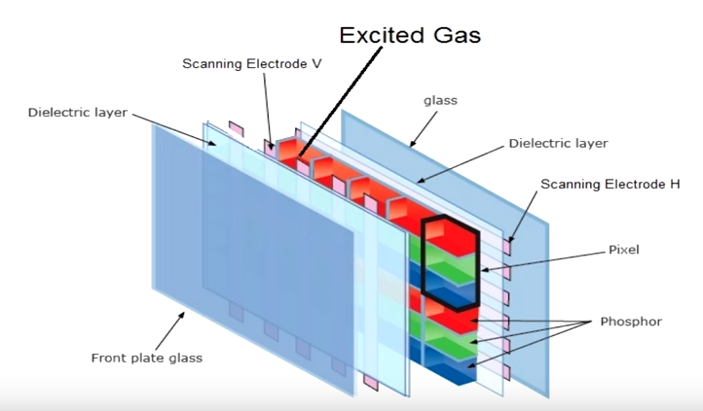
Plasma

Slide 4
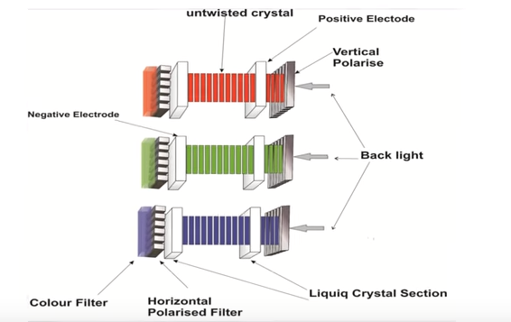
LCD

