Slide 1
Built-In Annotations
@Retention: It is designed to be used only as an annotation to another annotation.
@Documented annotation is a marker interface that tells a tool that an annotation is to be documented.
@Target annotation specifies the types of declarations to which an annotation can be applied.
@Target takes one argument, which must be a constant from the ElementType enumeration.

Slide 2
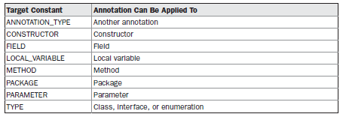
@Target( { ElementType.FIELD, ElementType.LOCAL_VARIABLE } )
specify that an annotation applies only to fields and local variables

Slide 3
@Inherited causes the annotation for a superclass to be inherited by a subclass.
@Override is a marker annotation that can be used only on methods. A method annotated with @Override must override a method from a superclass.
@SuppressWarnings specifies that one or more warnings that might be issued by the compiler are to be suppressed

Slide 4
The Collections Framework
The Collections Framework is a sophisticated hierarchy of interfaces and classes that provide state-of-the-art technology for managing groups of objects.
The implementations for the fundamental collections (dynamic arrays, linked lists, trees, and hash tables) are highly efficient.
The framework allows different types of collections
Extending and/or adapting a collection is easy.

Slide 5
The Collection Interfaces

Slide 6
Collection Interface
Collection is a generic interface that has this declaration: interface Collection<E>
Collection extends the Iterable interface. This means that all collections can be cycled through by use of the for-each style for loop.

Slide 7
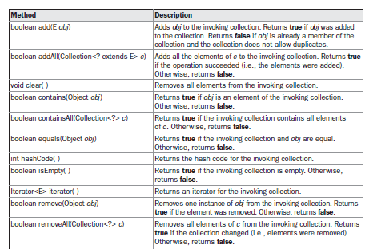

Slide 8
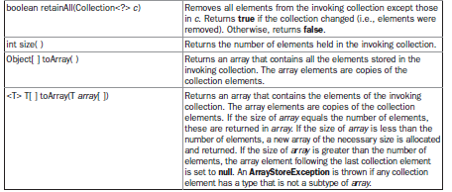

Slide 9
The List Interface
The List interface extends Collection and declares the behavior of a collection that stores a sequence of elements.
Elements can be inserted or accessed by their position in the list, using a zero-based index.
A list may contain duplicate elements.
List is a generic interface that has this declaration: interface List<E>

Slide 10
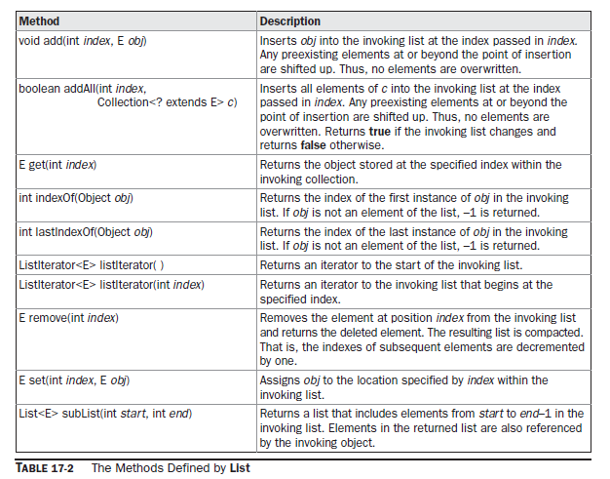

Slide 11
The Set Interface
The Set interface defines a set. It extends Collection and declares the behavior of a collection that does not allow duplicate elements.
the add( ) method returns false if an attempt is made to add duplicate elements to a set.
It does not define any additional methods of its own.
Set is a generic interface that has this declaration: interface Set<E>

Slide 12
The SortedSet Interface
The SortedSet interface extends Set and declares the behavior of a set sorted in ascending order.
SortedSet is a generic interface that has this declaration: interface SortedSet<E>

Slide 13
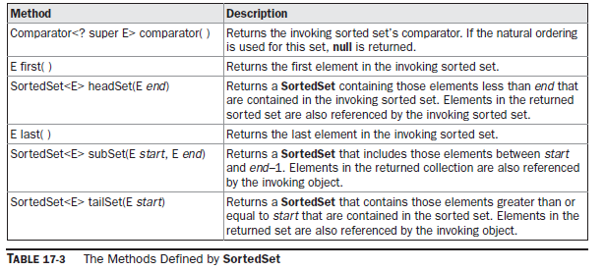

Slide 14
The NavigableSet Interface
It extends SortedSet and declares the behavior of a collection that supports the retrieval of elements based on the closest match to a given value or values.
NavigableSet is a generic interface that has this declaration: interface NavigableSet<E>

Slide 15
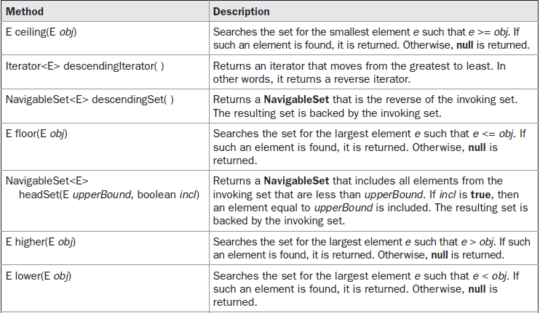

Slide 16
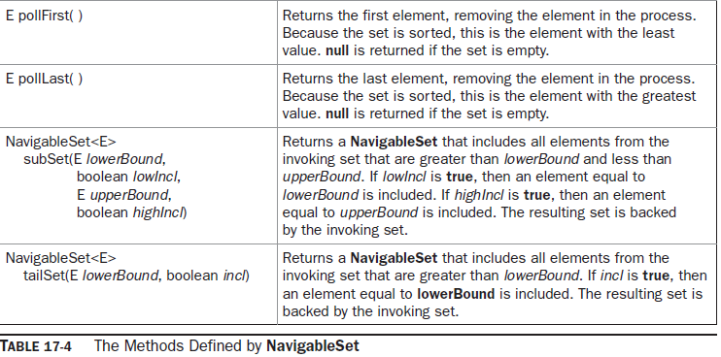

Slide 17
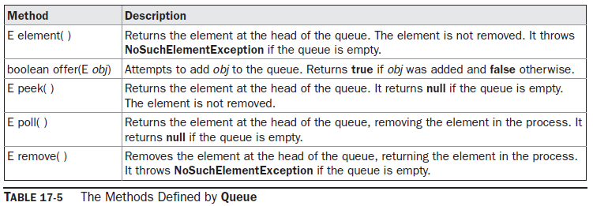
The Queue Interface
The Queue interface extends Collection and declares the behavior of a queue, which is often a first-in, first-out list.
Queue is a generic interface that has this declaration: interface Queue<E>

Slide 18
The Deque Interface
It extends Queue and declares the behavior of a double-ended queue.
Double-ended queues can function as standard, first-in, first-out queues or as last-in, first-out stacks.
Deque is a generic interface that has this declaration: interface Deque<E>

Slide 19
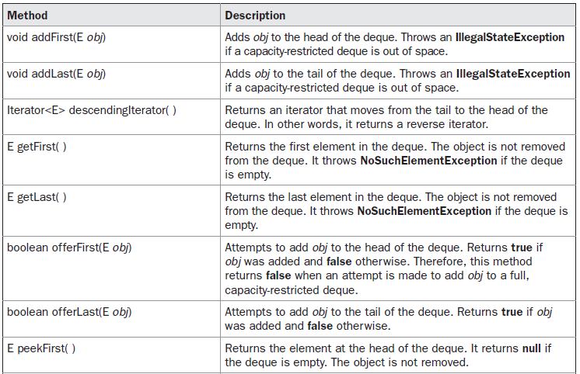

Slide 20
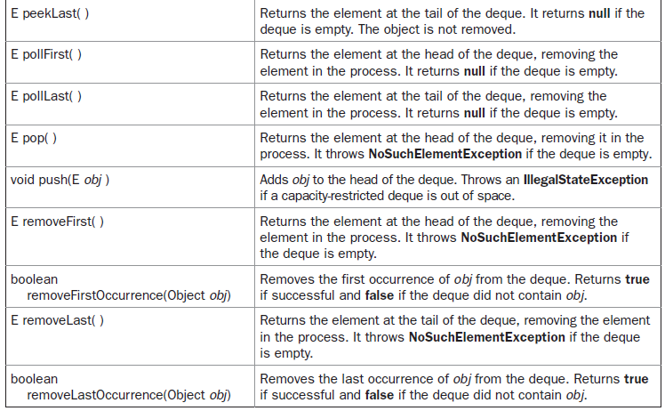

Slide 21
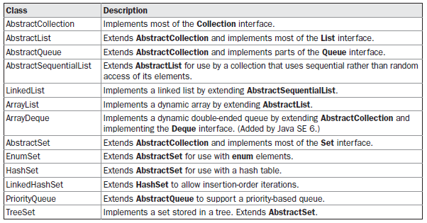
The Collection Classes

Slide 22
The ArrayList Class
The ArrayList class extends AbstractList and implements the List interface.
ArrayList is a Generic class that has this declaration:class ArrayList<E>
ArrayList supports dynamic arrays that can grow as needed.
ArrayList( )
ArrayList(Collection<? extends E> c)
ArrayList(int capacity)

Slide 23
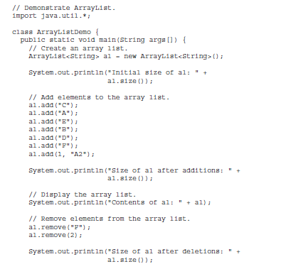

Slide 25
Obtaining an Array from an ArrayList
When working with ArrayList, you will sometimes want to obtain an actual array that contains the contents of the list.
Several reasons exist why you might want to convert a collection into an array,
To obtain faster processing times for certain operations
To pass an array to a method that is not overloaded to accept a collection
To integrate collection-based code with legacy code that does not understand collections
Object[ ] toArray( )
<T> T[ ] toArray(T array[ ])

Slide 26
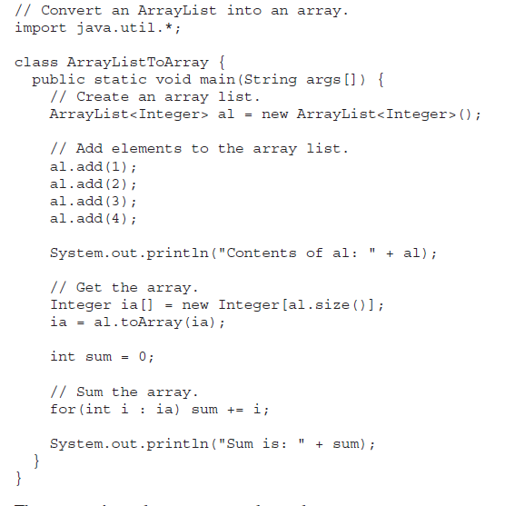

Slide 27
The LinkedList Class
LinkedList class extends AbstractSequentialList and implements the List, Deque, and Queue interfaces.
LinkedList is a generic class that has this declaration: class LinkedList<E>
LinkedList( )
LinkedList(Collection<? extends E> c)

Slide 28
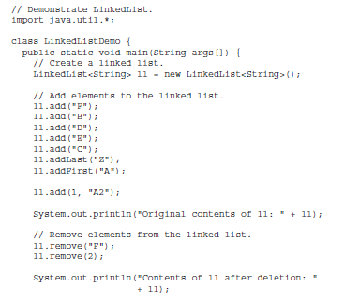

Slide 29
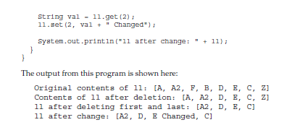

Slide 30
The HashSet Class
HashSet extends AbstractSet and implements the Set interface.
It creates a collection that uses a hash table for storage.
class HashSet<E>
HashSet( ) →16
HashSet(Collection<? extends E> c)
HashSet(int capacity)
HashSet(int capacity, float fillRatio)

Slide 31
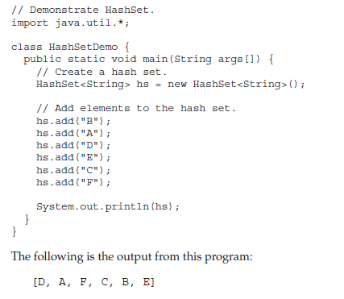

Slide 32
The LinkedHashSet Class
The LinkedHashSet class extends HashSet and adds no members of its own.
LinkedHashSet maintains a linked list of the entries in the set, in the order in which they were inserted.
The output will be [B, A, D, E, C, F]
which is the order in which the elements were inserted.

Slide 33
The TreeSet Class
TreeSet extends AbstractSet and implements the NavigableSet interface.
It creates a collection that uses a tree for storage.
Objects are stored in sorted, ascending order. Access and retrieval times are quite fast, which makes TreeSet an excellent choice when storing large amounts of sorted information that must be found quickly.
class TreeSet<E>
TreeSet( )
TreeSet(Collection<? extends E> c)
TreeSet(Comparator<? super E> comp)
TreeSet(SortedSet<E> ss)

Slide 34
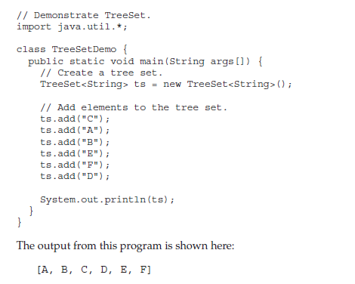

Slide 35
The PriorityQueue Class
PriorityQueue extends AbstractQueue and implements the Queue interface.
class PriorityQueue<E>
PriorityQueue( )
PriorityQueue(int capacity)
PriorityQueue(int capacity, Comparator<? super E> comp)
PriorityQueue(Collection<? extends E> c)
PriorityQueue(PriorityQueue<? extends E> c)
PriorityQueue(SortedSet<? extends E> c)

Slide 36
The ArrayDeque Class
Java SE 6 added the ArrayDeque class, which extends AbstractCollection and implements the Deque interface.
It adds no methods of its own.
ArrayDeque creates a dynamic array and has no capacity restrictions.
class ArrayDeque<E>
ArrayDeque( )
ArrayDeque(int size)
ArrayDeque(Collection<? extends E> c)

Slide 37
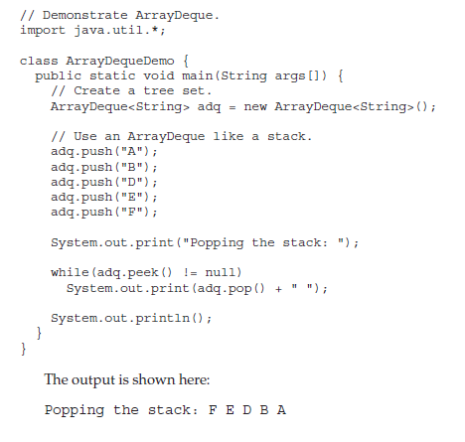

Slide 38
The PriorityQueue Class
PriorityQueue extends AbstractQueue and implements the Queue interface.
class PriorityQueue<E>
PriorityQueue( ) →11
PriorityQueue(int capacity)
PriorityQueue(int capacity, Comparator<? super E> comp)
PriorityQueue(Collection<? extends E> c)
PriorityQueue(PriorityQueue<? extends E> c)
PriorityQueue(SortedSet<? extends E> c)

Slide 39
The ArrayDeque Class
ArrayDeque class, which extends AbstractCollection and implements the Deque interface.
ArrayDeque creates a dynamic array and has no capacity restrictions.
class ArrayDeque<E>
ArrayDeque( ) →16
ArrayDeque(int size)
ArrayDeque(Collection<? extends E> c)

Slide 40
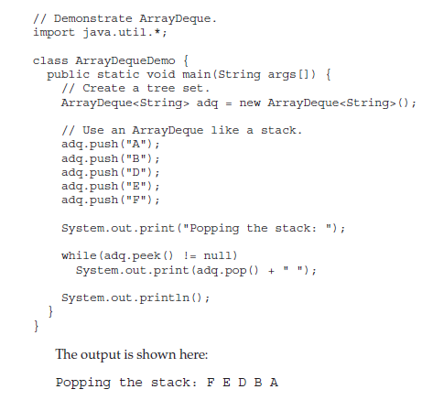

Slide 41
Accessing a Collection via an Iterator
Iterator enables you to cycle through a collection, obtaining or removing elements.
ListIterator extends Iterator to allow bidirectional traversal of a list, and the modification of elements.
interface Iterator<E>
interface ListIterator<E>

Slide 42
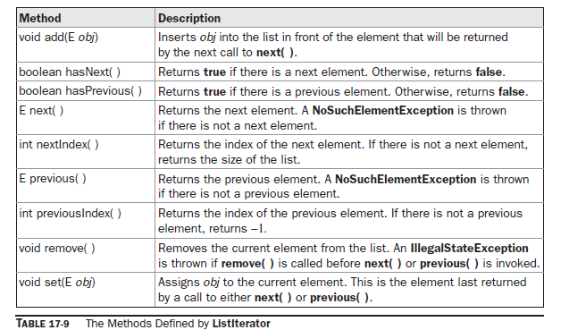

Slide 43
Obtain an iterator to the start of the collection by calling the collection’s iterator( ) method.
Set up a loop that makes a call to hasNext( ). Have the loop iterate as long as hasNext( ) returns true.
Within the loop, obtain each element by calling next( ).

Slide 44
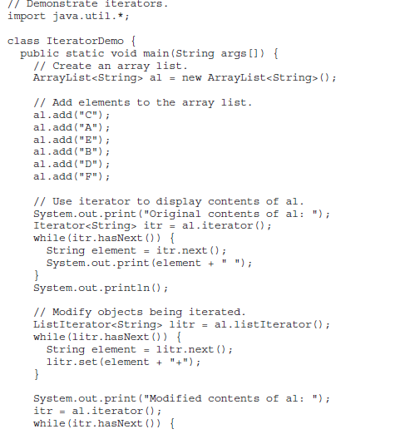

Slide 45
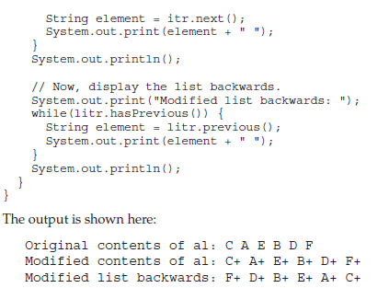

Slide 46
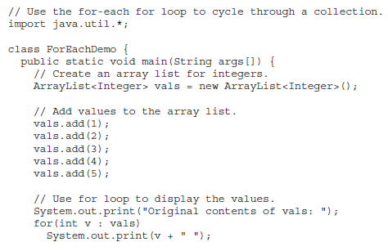
The For-Each Alternative to Iterators

Slide 47
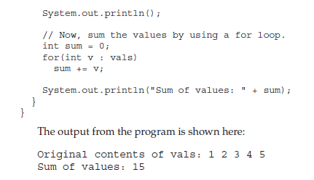

Slide 48
Storing User-Defined Classes in Collections
the foregoing examples have stored built-in objects, such as String or Integer, in a collection.
The power of collections is that they can store any type of object, including objects of classes that you create.

Slide 49
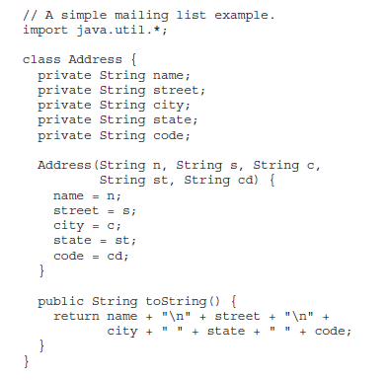

Slide 50
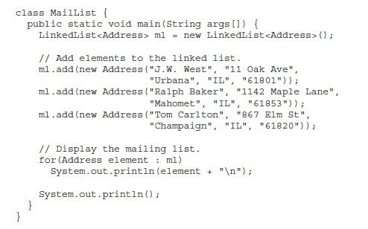
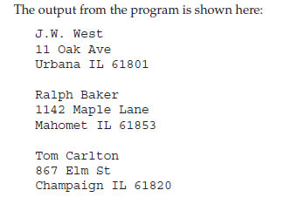

Slide 51
Working with Maps
A map is an object that stores associations between keys and values, or key/value pairs.
Given a key, you can find its value.
Both keys and values are objects.
The keys must be unique, but the values may be duplicated.
they don’t implement the Iterable interface.
But, you can obtain a collection-view of a map, which does allow the use of either the for loop or an iterator.

Slide 52
The Map Interfaces

Slide 53
The Map Interface
The Map interface maps unique keys to values.
Given a key and a value, you can store the value in a Map object. After the value is stored, you can retrieve it by using its key.
interface Map<K, V>
Here, K specifies the type of keys, and V specifies the type of values.

Slide 54
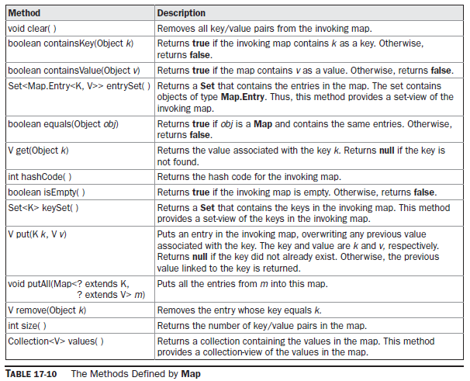

Slide 55
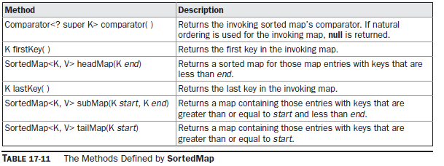
The SortedMap Interface
The SortedMap interface extends Map, It ensures that the entries are maintained in ascending order based on the keys.
interface SortedMap<K, V>

Slide 56
The NavigableMap Interface
It extends SortedMap and declares the behavior of a map that supports the retrieval of entries based on the closest match to a given key or keys.
interface NavigableMap<K,V>

Slide 57
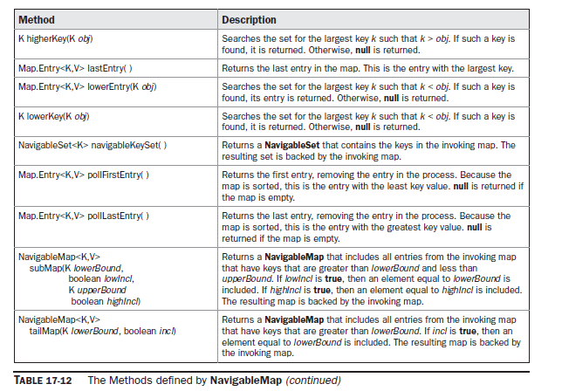

Slide 58
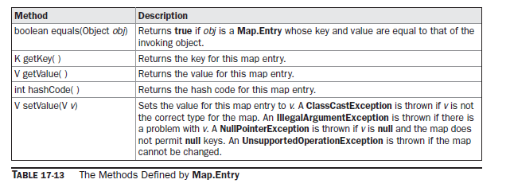
The Map.Entry Interface
The Map.Entry interface enables you to work with a map entry.
interface Map.Entry<K, V>

Slide 59
The Map Classes
Several classes provide implementations of the map interfaces.

Slide 60
The HashMap Class
The HashMap class extends AbstractMap and implements the Map interface.
It uses a hash table to store the map.
class HashMap<K, V>
HashMap( ) →16
HashMap(Map<? extends K, ? extends V> m)
HashMap(int capacity)
HashMap(int capacity, float fillRatio)

Slide 61
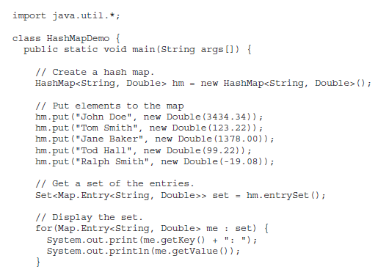

Slide 62
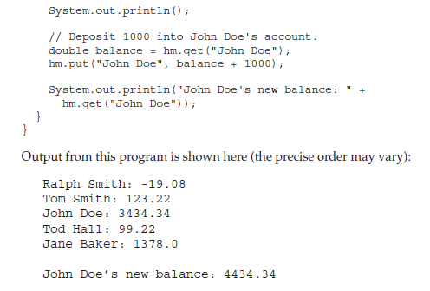

Slide 63
The TreeMap Class
The TreeMap class extends AbstractMap and implements the NavigableMap interface.
It creates maps stored in a tree structure.
TreeMap provides an efficient means of storing key/value pairs in sorted order and allows rapid retrieval.
a tree map guarantees that its elements will be sorted in ascending key order.
class TreeMap<K, V>

Slide 64
TreeMap( )
TreeMap(Comparator<? super K> comp)
TreeMap(Map<? extends K, ? extends V> m)
TreeMap(SortedMap<K, ? extends V> sm)
TreeMap has no methods beyond those specified by the NavigableMap interface and the AbstractMap class.

Slide 65
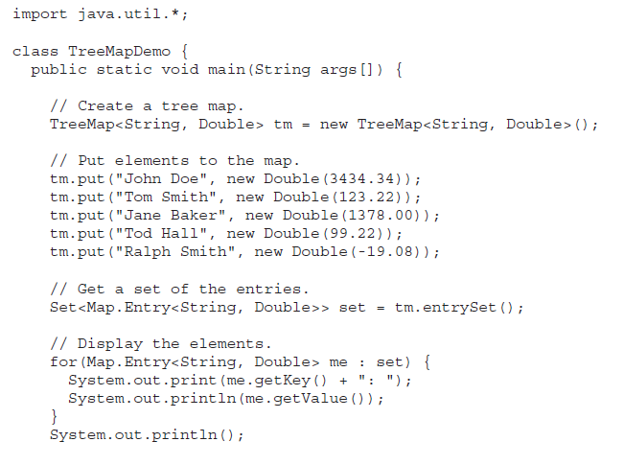

Slide 66
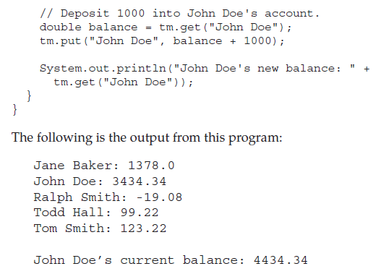

Slide 67
The LinkedHashMap Class
LinkedHashMap extends HashMap
It maintains a linked list of the entries in the map, in the order in which they were inserted.
Class LinkedHashMap<K,V>
LinkedHashMap() →16
LinkedHashMap(Map<? Extends K,? Extends V>m);
LinkedHashMap(int capacity)
LinkedHashMap(int capacity, float fillratio);
LinkedHashMap(int capacity, float fillratio, boolen order)

Slide 68
Comparators
Both TreeSet and TreeMap store elements in sorted order. However, it is the comparator that defines precisely what “sorted order” means.
By default, these classes store their elements by using what Java refers to as “natural ordering”
If you want to order elements a different way, then specify a Comparator when you Construct the set or map.
interface Comparator<T>
Here, T specifies the type of objects being compared.

Slide 69
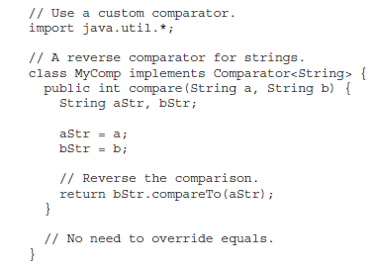
Comparator interface defines two methods
int compare(T obj1, T obj2)
boolean equals(Object obj)

Slide 70
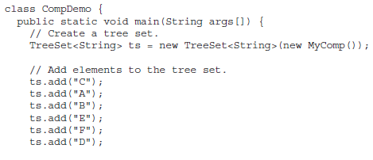
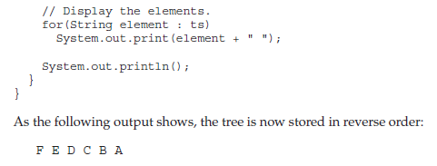

Slide 71
The Collection Algorithms
The Collections Framework defines several algorithms that can be applied to collections and maps.
These algorithms are defined as static methods within the Collections class.

Slide 72
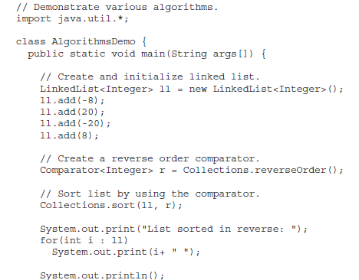

Slide 73
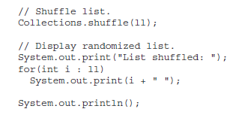
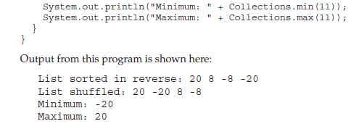

Slide 74
Arrays
The Arrays class provides various methods that are useful when working with arrays.
static <T> List asList(T ... array): The asList( ) method returns a List that is backed by a specified array.

Slide 75
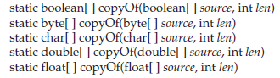
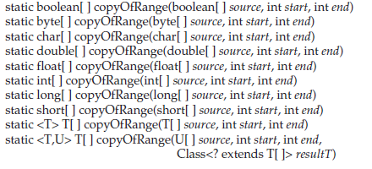

Slide 76
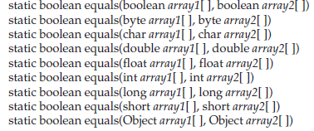
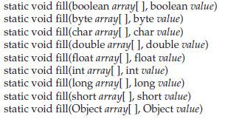

Slide 77
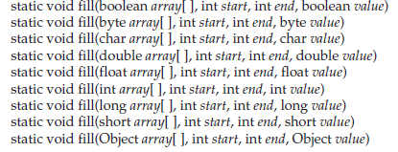
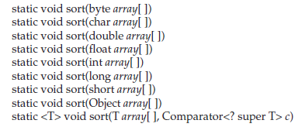

Slide 78
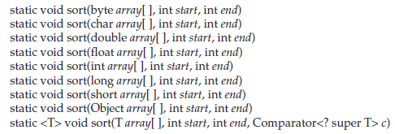

Slide 79
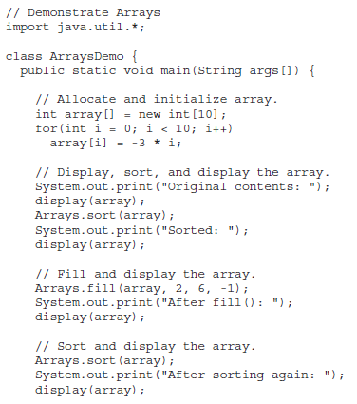

Slide 80
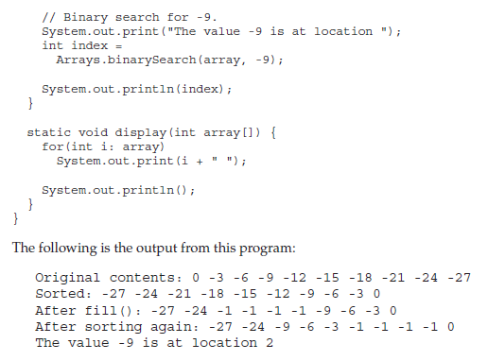

Slide 81
The Legacy Classes and Interfaces
Dictionary
Hashtable
Properties
Stack
Vector

Slide 82
Vector
Vector implements a dynamic array
class Vector<E>
Vector( ) →10
Vector(int size)
Vector(int size, int incr)
Vector(Collection<? extends E> c)
int capacityIncrement;
int elementCount;
Object[ ] elementData;

Slide 85
Stack
Stack is a subclass of Vector that implements a standard last-in, first-out stack.
class Stack<E>

Slide 87
Dictionary
Dictionary is an abstract class that represents a key/value storage repository and operates much like Map.

Slide 88
Properties
Properties is a subclass of Hashtable. It is used to maintain lists of values in which the key is a String and the value is also a String.

