Slide 1
S. J. P. N. TRUST’S HIRASUGAR INSTITUTE OF TECHNOLOGY, NIDASOSHI Accredited at 'A' Grade by NAAC Programmes Accredited by NBA: CSE, ECE, EEE & ME.
Department of Computer Science & Engineering
Course: Design And Analysis of Algorithms (18CS42)
Module 5: Backtracking, Program & Bound, 0/1 Knapsack Problem, NP-Hard & NP-Complete Problems
Prof. C. R. Belavi
Asst. Prof. , Dept. of Computer Science & Engg.,
Hirasugar Institute of Technology, Nidasoshi

Slide 2
Module – 5 Backtracking
General Method (T2:7.1)
n-Queens Problem (T1:12.1)
Sum of Subset Problem (T1:12.1)
Graph coloring (T2:7.4)
Hamiltonian Cycle (T2:7.5)

Slide 3
Backtracking General Method
The desired solution is expressible as an n-tuple (x₁,…..,x_{n}), where the x_{i} are chosen from some finite set Si
Often the problem to be solved calls for finding one vector that maximizes ( or minimizes or satisfies ) a criterion function P(x₁,…..,x_{n})
Sometimes it seeks all vectors that satisfy P
Suppose m is the size of set S_{i}, then there are m = m₁m₂….m_{n}, n-tuples that are possible candidates for satisfying the function P
Its basic idea is to build up the solution vector one component at a time and to use modified criterion function P_{i}(x₁, x₂ ,…,x_{i}) (sometimes called bounding function) to test whether the vector being formed has any chance to of success
Major advantages of this method is this – if it is realized that the partial vector (x₁, x₂ ,…….,x_{i}) can in no way lead to an optimal solution, then m_{i+1}….m_{n} possible test vectors can be ignored entirely

Slide 4
Backtracking General Method
The principle idea is to construct solutions one component at a time and evaluate such partially constructed candidates as follows
If a partially constructed solution can be developed further without violating the problem’s constraints, it is done by taking the first remaining legitimate option for the next component
If there is no legitimate option for the next component, no alternatives for any remaining component need to be considered

Slide 5
Backtracking General Method
In this case, the algorithm backtracks to replace the last component of the partially constructed solution with its next option
This kind of backtracking is implemented by constructing a tree called as state-space tree(SST)
In SST, its root represent an initial state before the search for a solution begins
The nodes of first level in the SST represent the choices made for the first component of a solution
The nodes of the second level represent the choices for the second component and so on

Slide 6
Module - 5
Backtracking
n-Queens Problem
Mr. C. R. BELAVI
Dept. of CSE,
HIT, Nidasoshi

Slide 7
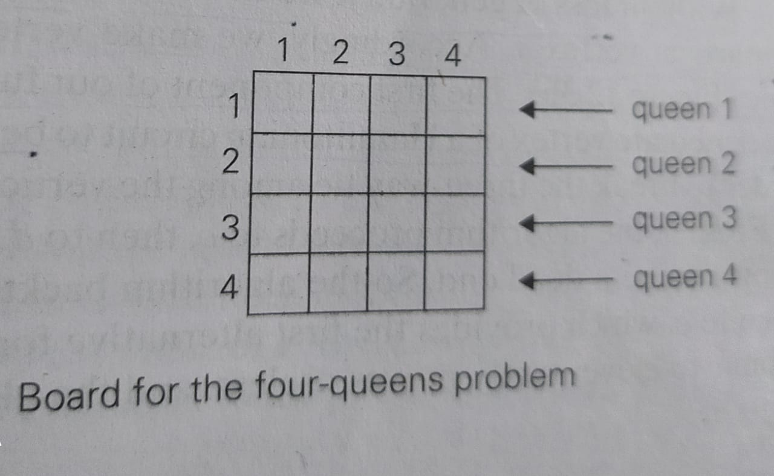
n-Queens Problem
The problem is to place n queens on an n-by-n chessboard so that no TWO queens attack each other by being in the same row or in the same column or on the same diagonal
For n=1, the problem has a trivial solution
For n=2 and n=3, there is no solution
So let us consider, n=4, i.e. four-queens problem and solve it by the backtracking technique

Slide 8
State-Space Tree for n-Queens Problem

Slide 9
Module - 5
Backtracking
Sum of subset Problem
Mr. C. R. BELAVI
Dept. of CSE,
HIT, Nidasoshi

Slide 10
Sum of Subset Problem
Find a subset of a given set S = { s₁, s₂, …. s_{n} } of n positive integers whose sum is equal to a given positive integer d
For example, for S = { 1, 2, 5, 6, 8 } and d=9
Then there are two solutions:-
Subset1 = { 1, 2, 6 } = 9
Subset2 = { 1, 8 } = 9
Of course, some instances of such problem is not possible i.e. if d=23
For convenient, all the set elements are sorted in increasing order as shown below-
s₁ ≤ s₂ ≤ ….. ≤ s_{n}

Slide 11
Sum of subset example S = { 3, 5, 6, 7 } and d = 15

Slide 12
Module - 5
Backtracking
Graph Coloring Problem
Mr. C. R. BELAVI
Dept. of CSE,
HIT, Nidasoshi

Slide 13
Graph Coloring
Let G be a graph and m be a given positive integer
Then the nodes of graph G can be colored in such a way that no TWO adjacent nodes have the same color yet only m colors are used
This is termed the m-colorability decision problem
If d is the degree of graph, then it can be colored with d+1 colors
The m-colorability optimization problem asks for the smallest integer m for which the graph G can be colored
This integer is referred to as the chromatic number of the graph

Slide 14
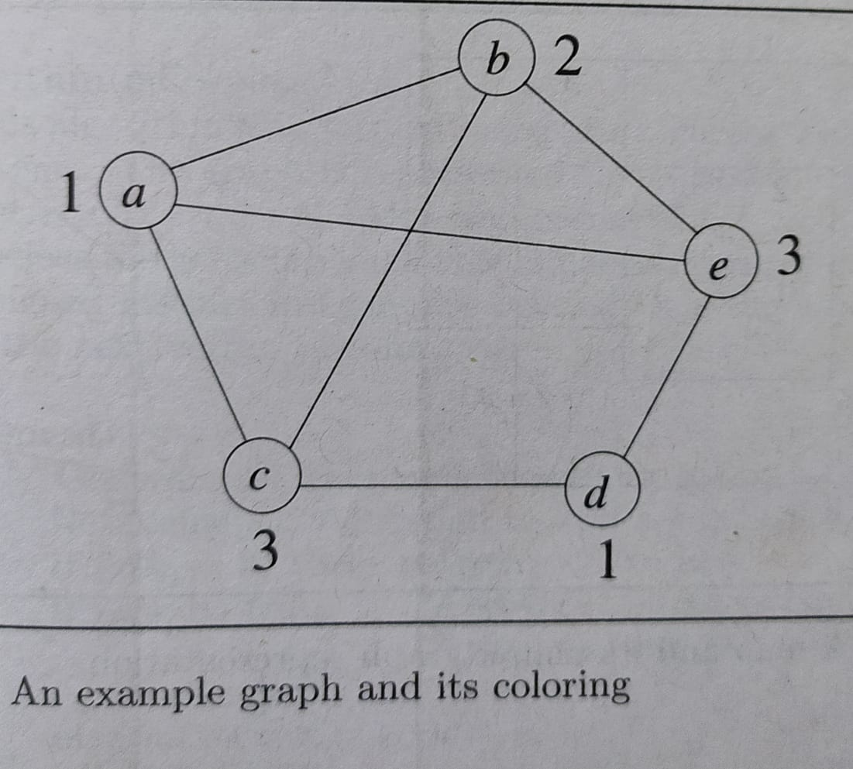
The above graph can be colored with three colors 1, 2 and 3
The color of each node is indicated next to it
Three colors are needed to color this graph and hence this graph’s chromatic number is 3

Slide 15
Graph Coloring Algorithm

Slide 16
4-node Graph & all possible 3 coloring

Slide 17
Module - 5
Backtracking
Hamiltonian Cycle
Mr. C. R. BELAVI
Dept. of CSE,
HIT, Nidasoshi

Slide 18
Hamiltonian Cycle
Let G = ( V, E ) be a connected graph wirh n vertices
A Hamiltonian cycle is a round-trip path along n edges of G that visits every vertex once and returns to its starting position
In other words if a Hamiltonian cycle begins at some vertex v₁ ϵ G and the vertices of G are visited in the order v₁,v₂,….,V_{n+1}, then the edges (v_{i}, v_{i+1}) are in E, 1 ≤ i ≤ n, and the v_{i} are distinct except for v₁ and v_{n+1}, which are equal

Slide 19
Hamiltonian Cycle Algorithm

Slide 20
Module - 5
Branch & Bound
Mr. C. R. BELAVI
Dept. of CSE,
HIT, Nidasoshi

Slide 21
Branch-and-Bound
Branch-and-Bound is similar to backtracking, but it cut off a branch of the problem’s state-space tree as soon as we can deduce that it cannot lead to a solution
This idea is useful to find an optimization problem, one that seeks to minimize or maximize an objective function, usually subject to some constrains
A feasible solution is a point in the problem’s search space that satisfies all the problem’s constraints
While, an optimal solution is a feasible solution with the best value of the objective function

Slide 22
Branch-and-Bound Algorithm
Three reasons to terminate a search path at the current node in a state-space tree of a branch-and-bound algorithm-
The value of the node’s bound is not better than the value of the best solution seen so far
The node represents no feasible solutions because the constraints of the problem are already violated
The subset of feasible solutions represented by the node consists of a single point ( and hence no further choices can be made )

Slide 23
Assignment Problem Statement
Assignment problem is a problem of assigning n people to n jobs so that the total cost of the assignment is as small as possible
An instance of the assignment problem is specified by an n-by-n cost matrix C so that we can state the problem as follows - select one element in each row of the matrix so that no two selected elements are in the same column and their sum is the smallest possible

Slide 24
Assignment Problem Solution

Slide 25
Assignment Problem Solution

Slide 26
Assignment Problem- Optimal(Minimum) Solution a->2, b->1, c->3, d->4 = 2 + 6 + 1 + 4 = 13

Slide 27
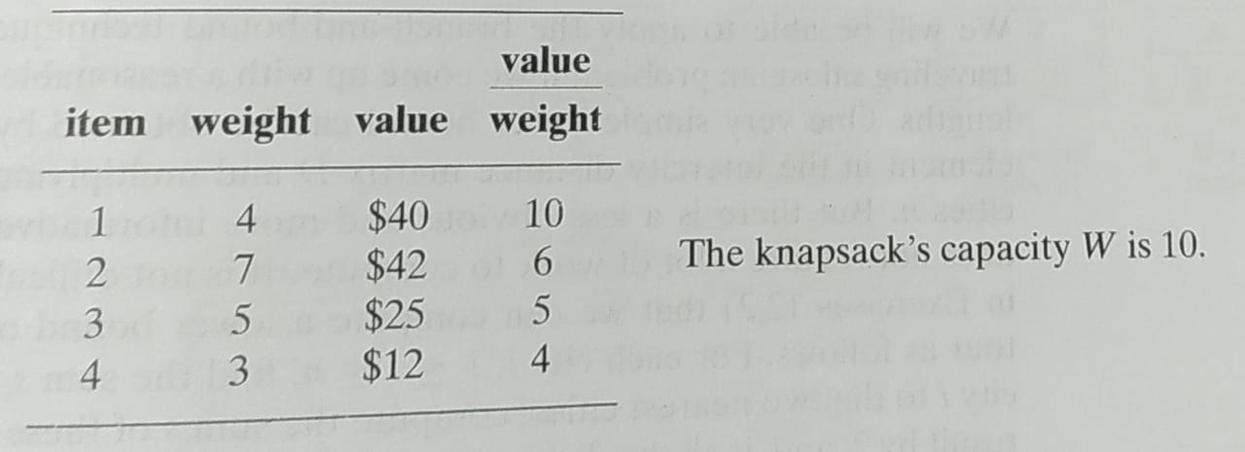
BRANCH-AND-BOUND Knapsack Problem
Given n items of known weights w_{i} and the values v_{i}, where i = 1, 2, 3, …, n, and a knapsack of capacity W, find the most valuable subset of the items that fit in the knapsack
For convenient, must arrange items in descending order by their value-to-weight ratios as shown in below example-

Slide 28
Knapsack Problem Solution

Slide 29
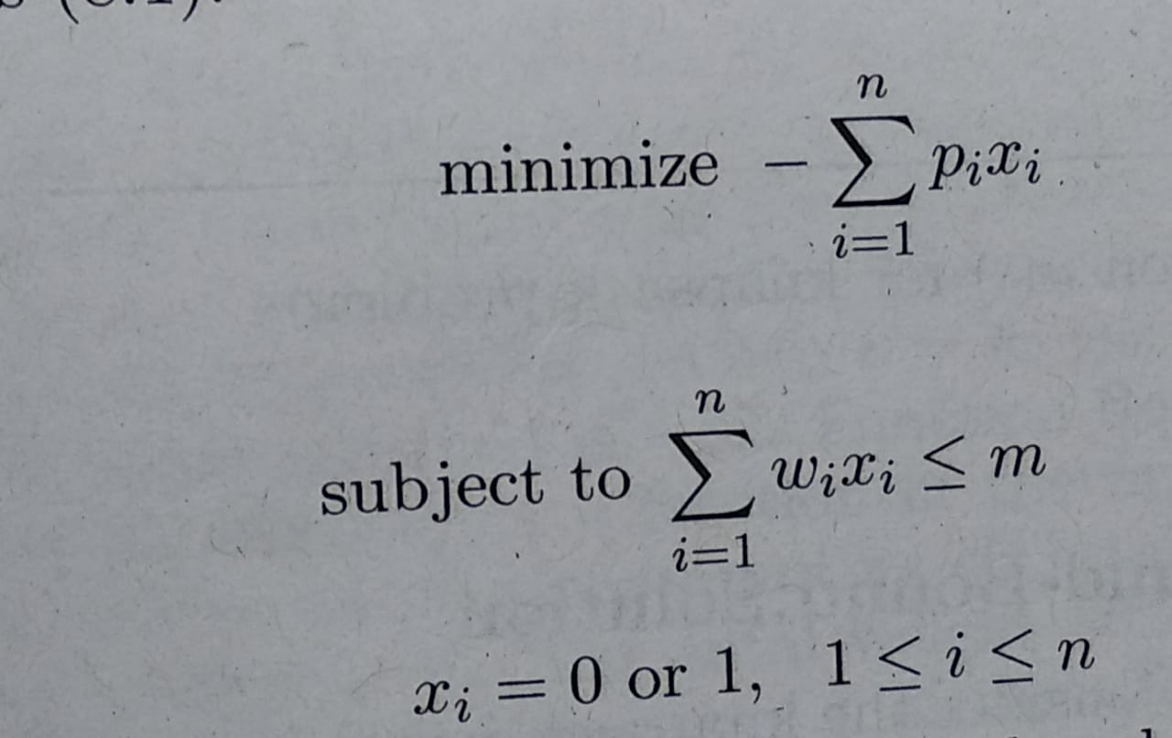
LC(Least Cost) Branch and Bound Solution
To use branch and bound technique to solve any problem we need to construct state space tree for given problem
As we know that 0/1 Knapsack problem is maximization problem(to get maximum profit), here we will solve it using minimization problem
Clearly, Ʃp_{i}x_{i} is maximized iff –Ʃp_{i}x_{i} is minimized
This modified 0/1 knapsack problem is stated as below-

Slide 30
For LCBB example - Consider the 0/1 Knapsack instance n=4,(p₁,p₂,p₃,p₄)=(10,10,12,18), (w₁,w₂,w₃,w₄)=(2,4,6,9) and m=15

Slide 31
For FIFOBB Example - Consider the 0/1 Knapsack instance n=4,(p₁,p₂,p₃,p₄)=(10,10,12,18), (w₁,w₂,w₃,w₄)=(2,4,6,9) and m=15

Slide 32
NP Complete and NP Hard Problems Basic Concept
In this chapter we are concerned with the distinction between problems that can be solved by a polynomial time algorithm and problems for which no polynomial time algorithm is known
For many of the problems we know and study, the best algorithms for their solutions have computing times that cluster into two groups
First group consists of problems whose solution times are bounded by polynomial of small degrees. Examples- Searching(O(logn)), Sorting(O(nlogn))
Second group made up of problems whose best-known algorithms are non-polynomials. Examples- Travelling Salesman Problem(O(n²2^{n})), Knapsack Problems(O(2^{n/2}))

Slide 33
NP Complete and NP Hard Problems Basic Concept
The theory of NP-completeness which we present here does not provide a method of obtaining polynomial time algorithms for problems in the second group
Nor does it say that algorithms of this complexity do not exist
Instead, what we do is show that many of the problems for which there are no known polynomial time algorithms are computationally related
In fact, we establish two classes of problems
These are given names NP-hard and NP-complete

Slide 34
NP Complete and NP Hard Problems Basic Concept
A problem that is NP-complete has the property that it can be solved in polynomial time if and only if all other NP-complete problems can also be solved in polynomial time
If an NP-hard problem can be solved in polynomial time, then all NP-complete problems can be solved in polynomial time
All NP-complete problems are NP-hard, but some NP-hard problems are not known to be NP-complete

Slide 35
NP Complete and NP Hard Problems Non-Deterministic Algorithm
Deterministic algorithm has the property that the result of every operation is uniquely defined
Deterministic algorithms agrees with the way programs are executed on a computer
Non-deterministic algorithm remove restriction on the outcome of every operation
Also non-deterministic algorithm allow to contain operations whose outcomes are not uniquely defined but are limited to specified sets of possibilities
Non-deterministic function introduces three new functions-
Choice(S) arbitrarily chooses one of the element of set S
Failure() signals an unsuccessful completion
Success() signals a successful completion

Slide 36
Non-Deterministic Algorithms

Slide 37
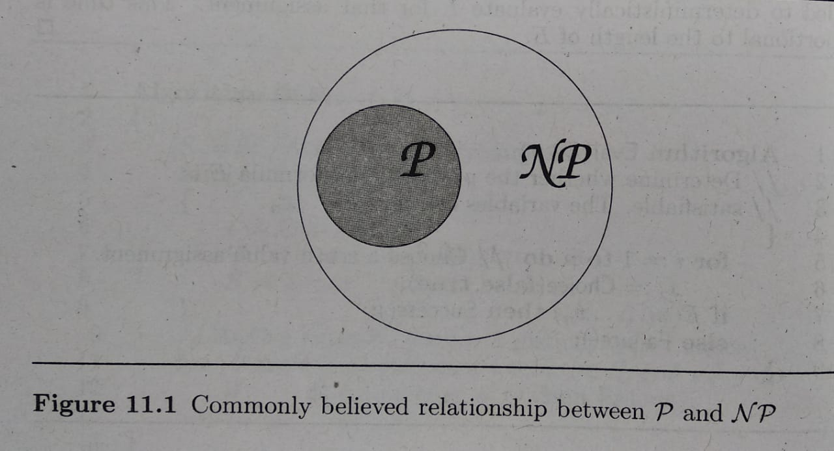
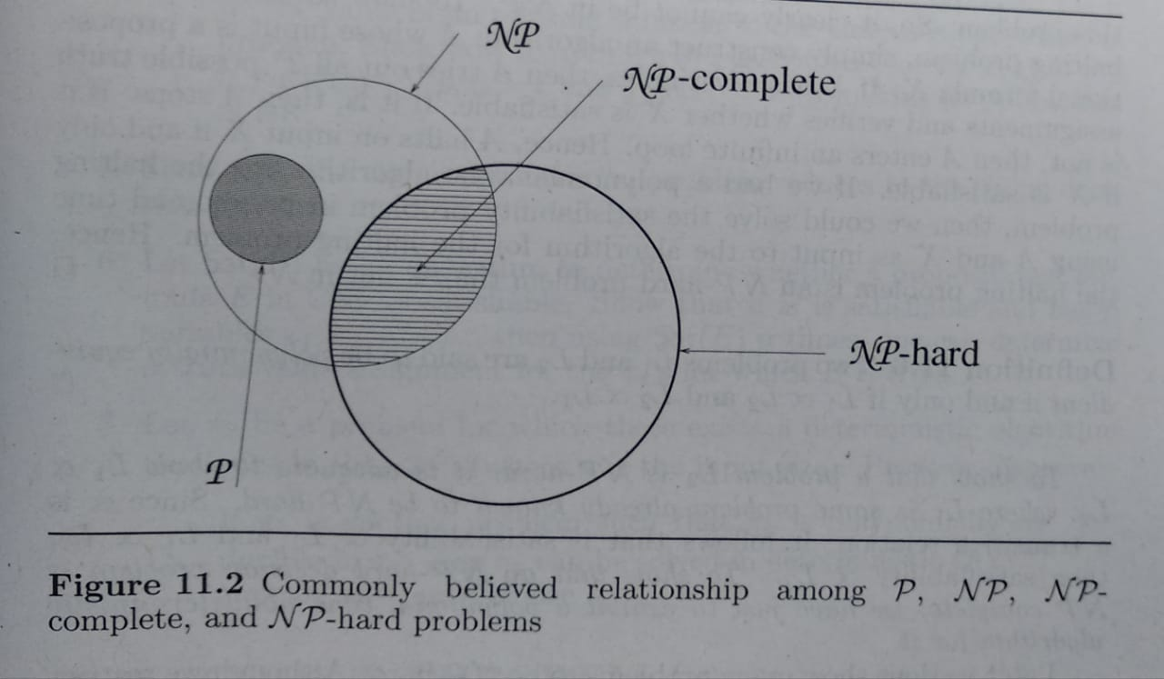
The Classes NP-hard and NP-complete
P is the set of all decision problems solvable by deterministic algorithms in polynomial time
NP is the set of all decision problems solvable by non-deterministic algorithms in polynomial time
From below figure, its clear that NP-hard problems that are not NP-complete
Only a decision problem can be NP-complete
However, an optimization problem may be NP-hard
Optimization problems cannot be NP-complete whereas decision problems can
There also exist NP-hard decision problems that are not NP-complete

