Slide 1
S. J. P. N. TRUST’S HIRASUGAR INSTITUTE OF TECHNOLOGY, NIDASOSHI Accredited at 'A' Grade by NAAC Programmes Accredited by NBA: CSE, ECE, EEE & ME.
Department of Computer Science & Engineering
Course: Design And Analysis of Algorithms (18CS42)
Module 4: Dynamic Programming,
Transitive Closure, All Pairs Shortest Path
Prof. C. R. Belavi
Asst. Prof. , Dept. of Computer Science & Engg.,
Hirasugar Institute of Technology, Nidasoshi

Slide 2
Module – 4 Dynamic Programming
General Method
Multistage Graphs
Transitive Closure – Warshall’s Algorithm
All Pairs-Shortest Path – Floyd’s Algorithm
Optimal Binary Search Tree
Knapsack Problem
Bellman-Ford Algorithm
Travelling Sales Person Problem
Reliability Design

Slide 3
Dynamic Programming General Method
Dynamic programming is an algorithm design method that can be used when the solution to a problem can be viewed as the result of a sequence of decisions
Dynamic programming is a technique used to obtain optimal solution to given real time examples
Examples:- Knapsack Problem, Shortest Path

Slide 4
Multistage Graphs
A multistage graph G=(V, E) is a directed graph in which the vertices are divided into k ≥ 2 disjoint sets V_{i}, 1 ≤ i ≤ k.
In addition, if(u, v) is an edge in E, then u ϵ V_{i} and v ϵ V_{i+1} for some i, 1 ≤ i ≤ k.
The sets V₁ and V_{k} are such that |V₁|=|V_{k}|=1.
The Multistage graph problem is to find a minimum cost path from source vertex s to sink vertex t in given multistage graph
The next figure shows a five-stage graph

Slide 5
Five-Stage Graph Example

Slide 6
Formula to find Minimum Cost from source s to sink t in Multistage Graph
cost(i, j) = min { c(j, l) + cost(i+1, l) }
Where,
cost(i, j) is cost of vertex j in stage i
c(j, l) is cost of edge from vertex j to vertex l
cost(i+1, l) is cost of vertex l in stage i+1
l ϵ V_{i+1}
<j, l> ϵ E

Slide 7
Multistage-Graph Example
cost(5,12) = 0
cost(4,9)=4 cost(4,10)=2 cost(4,11)=5
cost(3,6) = min { c(6,9) + cost(4,9), c(6,10) + cost(4,10) } = min { 6+4, 5+2} = min {10, 7} = 7
cost(3,7) = min { c(7,9) + cost(4,9), c(7,10) + cost(4,10) } = min { 4+4, 3+2} = min {8, 5} = 5
cost(3,8) = min { c(8,10) + cost(4,10), c(8,11) + cost(4,11) } = min { 5+2, 6+5} = min {7, 11} = 7
cost(2,2) = min { c(2,6) + cost(3,6), c(2,7) + cost(3,7), c(2,8) + cost(3,8) }
= min { 4+7, 2+5, 1+7 } = min { 11, 7, 8} = 7
cost(2,3) = min { c(3,6) + cost(3,6), c(3,7) + cost(3,7) } = min { 2+7, 7+5 } = min { 9, 12} = 9
cost(2,4) = min { c(4,8) + cost(3,8) } = min { 11+7} = min { 18 } = 18
cost(2,5) = min { c(5,7) + cost(3,7), c(5,8) + cost(3,8) } = min { 11+5, 8+7} = min {16, 15} = 15
cost(1,1) = min { c(1,2) + cost(2,2), c(1,3) + cost(2,3), c(1,4) + cost(2,4), c(1,5) + cost(2,5) }
= min { 9+7, 7+9, 3+18, 2+15} = min { 16, 16, 21, 17} = 16
Two optimal solutions are possible for above given example-
cost(1,1) = 2 cost(1,1) =3
cost(2,2) = 7 cost(2,3) = 6
cost(3,7) = 10 cost(3,6) = 10
cost(4,10) = 12 cost(4,10) = 12
Edges from source to sink 1 -> 2 -> 7 ->10 -> 12 Edges from source to sink 1 -> 3 -> 6 -> 10 -> 12
Cost from source to sink = 9 + 2 + 3 + 2 cost from source to sink = 7 + 2 + 5 + 2
= 16 = 16

Slide 8
Module - 4
Dynamic Programming
Transitive Closure
Warshall’s Algorithm
Mr. C. R. BELAVI
Dept. of CSE,
HIT, Nidasoshi

Slide 9
Transition Closure Definition
The Transitive closure of a directed graph with n vertices can be defined as the n-by-n Boolean matrix T = {t_{ij}}, in which the element in the ith row (1 ≤ i ≤ n) and the jth column (1 ≤ j ≤ n) is 1 if there exists a nontrivial directed path from the ith vertex to the jth vertex otherwise, t_{ij} is 0

Slide 10
Warshall’s algorithm Is used for computing the transitive closure of a directed graph

Slide 12
Warshall’s Algorithm Example
Through vertex a
( d, a) = 1 & ( a, b ) = 1, Hence ( d, b ) = 1
R⁽⁰⁾ Results into R⁽¹⁾
Through vertex b
( a, b ) = 1 & ( b, d ) = 1, Hence ( a, d ) = 1
( d, b ) = 1 & ( b, d ) = 1, Hence ( d, d ) = 1
R⁽¹⁾ Results into R⁽²⁾
Through vertex c
( d, c ) = 1 but no path from c to others. Hence, R⁽³⁾ remains same as R⁽²⁾
Through vertex d
( a, d ) = 1 & ( d, a ) = 1, Hence ( a, a ) = 1
( a, d ) = 1 & ( d, b ) = 1, Hence ( a, b ) = 1
( a, d ) = 1 & ( d, c ) = 1, Hence ( a, c ) = 1
( a, d ) = 1 & ( d, d ) = 1, Hence ( a, d ) = 1
( b, d ) = 1 & ( d, a ) = 1, Hence ( b, a ) = 1
( b, d ) = 1 & ( d, b ) = 1, Hence ( b, b ) = 1
( b, d ) = 1 & ( d, c ) = 1, Hence ( b, c ) = 1
( b, d ) = 1 & ( d, d ) = 1, Hence ( b, d ) = 1
R⁽³⁾ Results into R⁽⁴⁾
Finally R⁽⁴⁾ is Transitive Closure of above given Diagraph

Slide 13
Module - 4
Dynamic Programming
Floyd’s Algorithm
Mr. C. R. BELAVI
Dept. of CSE,
HIT, Nidasoshi

Slide 14
Floyd’s Algorithm ( All Pairs shortest path problem ) to find distance from each vertex to all other vertices

Slide 15
Floyd’s Algorithm Example

Slide 16
Floyd’s Algorithm Example
Through vertex a
( b, a ) = 2 and ( a, c ) = 3 ( b, c ) = min { ( b, c), ( b, a ) + ( a, c) }
= min { ∞, 2+3} = 5, ( b, c ) = 5
( d, a ) = 6 and ( a, c ) = 3 ( d, c ) = min { ( d, c), ( d, a ) + ( a, c) }
= min { ∞, 6+3} = 9, ( d, c ) = 9
D⁽⁰⁾ Results into D⁽¹⁾
Through Vertex b
( c, b ) = 7 and ( b, a ) = 2 ( c, a ) = min { ( c, a), ( c, b ) + ( b, a) }
= min {∞ , 7+2} = 9, ( c, a ) = 9
( c, b ) = 7 and ( b, c ) = 5 ( c, c ) = min { ( c, c), ( c, b ) + ( b, c) }
= min { 0, 7+5} = 0, ( c, c ) = 0
D⁽¹⁾ Results into D⁽²⁾
Through Vertex c
( a, c ) = 3 & ( c, a) = 9 hence, (a, a) = min { 0, 3+9 } = (a, a)= 0
( a, c ) = 3 & ( c, b) = 7 hence, (a,b) = min { ∞, 3+7 } = (a,b)= 10
( a, c ) = 3 & ( c, d) = 1 hence, (a, d) = min { ∞, 3+1 } = (a, d)=4
( b, c ) = 5 & ( c, a) = 9 hence, (b, a) = min { 2, 5+9 } = (b, a)= 2
( b, c ) = 5 & ( c, b) = 7 hence, (b, b) = min { 0, 5+7 } = (b, b)= 0
( b, c ) = 5 & ( c, d) = 1 hence, (b, d) = min { ∞, 5+1 } = (b, d)=6
( d, c ) = 9 & ( c, a) = 9 hence, (d, a) = min { 6, 9+9 } = (d, a)= 6
( d, c ) = 9 & ( c, b) = 7 hence, (d,b) = min { ∞, 9+7 } = (d,b)= 16
( d, c ) = 9 & ( c, d) = 1 hence, (d, d) = min { ∞, 9+1 } = (d, d)=0
D⁽²⁾ Results into D⁽³⁾

Slide 17
Floyd’s Algorithm Example
Through Vertex d
( a, d ) = 4 & ( d, a) = 6 hence, (a, a) = min { 0, 4 + 6 } = (a, a)= 0
( a, d ) = 4 & ( d,b)=16 hence,(a,b)=min{ 10, 4+16 } = (a,b)= 10
( a, d ) = 4 & ( d, c) = 9 hence, (a, c) = min { 3, 4 + 9 } = (a, c) = 3
( b, d ) = 6 & ( d, a) = 6 hence, (b, a) = min { 2, 6+6 } = (b, a)= 2
( b, d ) = 6 & ( d, b)=16 hence,(b, b)=min { 0, 6+16 } = (b, b)= 0
( b, d ) = 6 & ( d, c) = 9 hence, (b, c) = min { 5, 6+9 } = (b, c)=5
( c, d ) = 1 & ( d, a) = 6 hence, (c, a) = min { 9, 1+6 } = (c, a)= 7
( c, d ) = 1 & ( d, b)=16 hence, (c, b) = min { 7, 1+16 } = (c, b)= 7
( c, d ) = 1 & ( d, c) = 9 hence, (c, c) = min { 0, 1+9 } = (c, c)=0
D⁽³⁾ Results into D⁽⁴⁾
D⁽⁴⁾ is Resultant Distance Matrix for all pair shortest path

Slide 18
Module - 4
Dynamic Programming
Optimal Binary Search Tree ( OBST )
Mr. C. R. BELAVI
Dept. of CSE,
HIT, Nidasoshi

Slide 19
Optimal Binary Search Tree ( OBST )
A binary search tree is one of the most important data structures in computer science
Principal applications is to implement a dictionary, a set of elements of a set are with the operations of searching, insertion, and deletion
If probabilities of searching for elements of a set are known, it is natural to pose a question about an OBST for which the average number of comparisons in a search is the smallest possible

Slide 20
Optimal Binary Search Tree ( OBST )

Slide 21
Module - 4
Dynamic Programming
0/1 Knapsack Problem
Mr. C. R. BELAVI
Dept. of CSE,
HIT, Nidasoshi

Slide 22
0/1 Knapsack Problem
For given n items/objects of known weights w1, w2,…..w_{n} and values v1,v2,…..v_{n} and a knapsack of capacity W, find the most valuable subset of the items that fit into the knapsack
Assume all the weights and the knapsack capacity are positive integers
Also all items are non-divisible i.e. consider full item(1) or not consider(0)
Recurrence formula for knapsack problem is
V[i,j] = { max {V[i-1,j], vi + V[i-1, j-wi]} if j-wi ≥ 0
V[i-1,j] if j-wi ≤ 0
And the Initial Conditions are-
V[0,j] = 0 for j ≥ 0 and V[i,0] = 0 for i ≥ 0

Slide 23
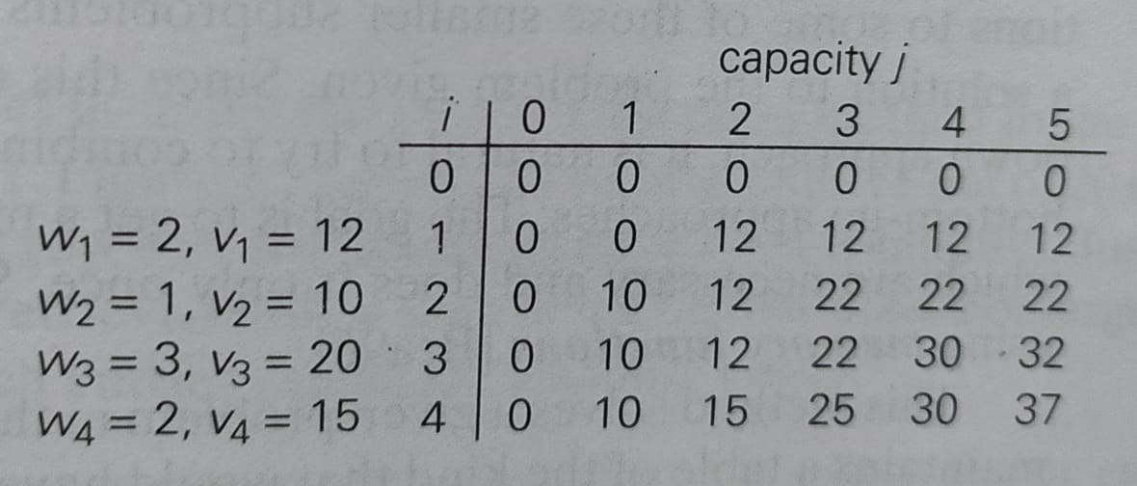
0/1 Knapsack with Size W=5
V[i, j] = max {V[i-1, j], v_{i} + V[i-1, j-w_{i} ]} if j-w_{i} ≥ 0
V[3,3] = max { V[2,3], 20+V[2,0] } = max { 22, 20+0 } = max {22, 20} = 22
V[3,4] = max { V[2,4], 20+V[2,1] } = max { 22, 20+10 } = max {22, 30}=30
V[3,5] = max { V[2,5], 20+V[2,2] } = max { 22, 20+12 } = max {22, 32}=32
V[4,3] = max { V[3,3], 15+V[3,1] } = max { 22, 15+10 }=max {22, 25} = 25
V[4,4] = max { V[3,4], 15+V[3,2] } = max { 30, 15+12 }=max {30, 27} = 30
V[4,5] = max { V[3,5], 15+V[3,3] } = max { 32, 15+22 }=max {32, 37} = 37
Finally subset of items = {1, 2, 3, 4} = { 1, 1, 0, 1}
Weight of Knapsack = {1, 2, 3, 4} = {2, 1, 0, 2} = 2 + 1 + 0 + 2 = 5 also maximum Knapsack capacity is, W=5
Maximum Profit Value = {1, 2, 3, 4} = {12, 10, 0, 15} = 12 + 10 + 0 + 15 = 37
Item | Weight | value
1 | 2 | 12
2 | 1 | 10
3 | 3 | 20
4 | 2 | 15

Slide 24
Module - 4
Dynamic Programming
Single Source Shortest Path
Bellman-Ford Algorithm
Mr. C. R. BELAVI
Dept. of CSE,
HIT, Nidasoshi

Slide 25
Bellman-Ford Algorithm
Single source shortest path is a problem in which consider one source vertex in a given weighted connected graph and find shortest paths to all its other vertices from source vertex
Dijkstra’s algorithm do not find the optimal path if graph having negative edges
Recurrence formula of Bellman-Ford algorithm is
dist^{k}[u] = min { dist^{k-1}[u], min_{i} { dist^{k-1}[i] + cost[i, u]}}
Where,
dist^{k}[u] is length of shortest path from source to vertex u
k are iterations in Bellman-ford algorithm for k = 2, 3, ………,n-1
i are the individual vertices in given graph G
n is the total number of vertices in given graph G

Slide 26
Bellman-Ford Algorithm

Slide 27
Formula - dist^{k}[u] = min { dist^{k-1}[u], min_{i} { dist^{k-1}[i] + cost[i, u]}}
When k=1 then
dist¹[1]=0, dist¹[2]=6, dist¹[3]=5, dist¹[4]=5, dist¹[5]= ∞, dist¹[6]=∞, dist¹[7]=∞
When k=2 then
dist²[2] = min { dist¹[2], min_{i} dist¹[i] + cost[i,2] } ( where i= 1 to 7 except 2 )
= min { 6, 0+6, 5+(-2), 5+∞, ∞+∞, ∞+∞, ∞+∞}
= min { 6, 6, 3, ∞, ∞, ∞, ∞ } = 3
Similarly when k=6
dist⁶[7] = min { dist⁵[7], min_{i} dist⁵[i] + cost[i,7] } ( where i= 1 to 7 except 7 )
= min { 3, 0+∞, 1+∞, 3+∞, 5+∞, 0+3, 4+3}
= min { 3, ∞, ∞, ∞, ∞, 3, 7} = 3
Similarly calculate, all the values as shown in above table using recurrence formula for Bellman-Ford Algorithm

Slide 28
Final Single source shortest path

Slide 29
Module - 4
Dynamic Programming
Travelling Sales Person Problem
Mr. C. R. BELAVI
Dept. of CSE,
HIT, Nidasoshi

Slide 30
Travelling Sales Person Problem
The travelling sales person problem is to find a tour of minimum cost
The variables c_{ij} is defined such that c_{ij} > 0 for all i and j and c_{ij} = ∞ if <i,j> ɇ E. Let |V| = n and assume n > 1. A tour of G is a directed simple cycle that includes every vertex in V. The cost of a tour is the sum of the cost of the edges on the tour.
Example:- A postal van to pick up mail from mail boxes located at n different sites where one vertex represent the post office from which the postal van starts and to which it must return
Formula- g(i,S) = min_{jϵS} { c_{ij} + g(j, S-{j})}
Where,
S is set of vertices except vertex i
c_{ij} is cost of edge from i to j
S-{j} is set of vertices expect vertex i and j

Slide 31
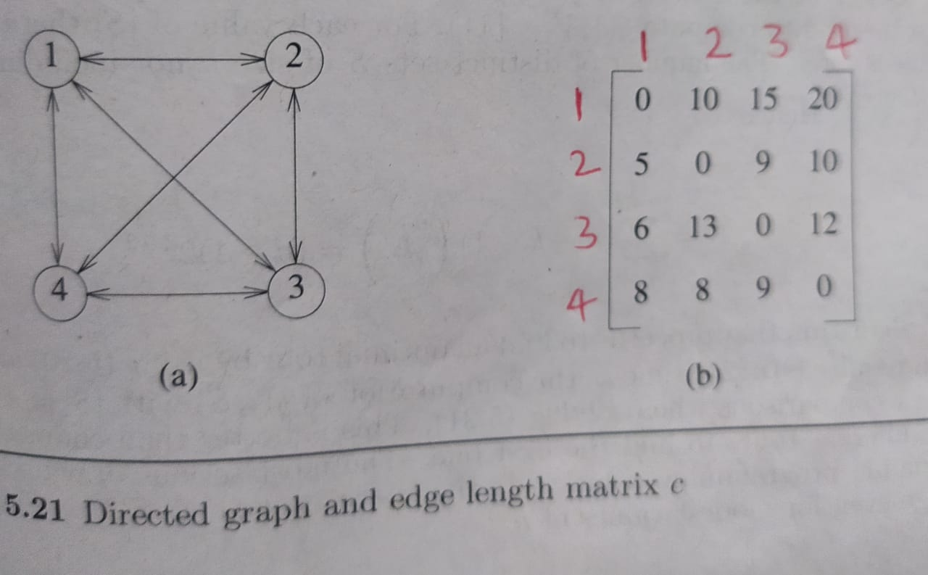
When set |S|=1 then
g(2,ф) = c₂₁ = 5 g(3,ф) = c₃₁ = 6 g(4,ф) = c₄₁ = 8
When set |S|=2 then
g(2,{3}) = c₂₃ + g(3,ф) = 9 + 6 = 15
g(2,{4}) = c₂₄+ g(4,ф) = 10 + 8 = 18
g(3,{2}) = c₃₂ + g(2,ф) = 13 + 5 = 18
g(3,{4}) = c₃₄ + g(4,ф) = 12 + 8 = 20
g(4,{2}) = c₄₂ + g(2,ф) = 8 + 5 = 13
g(4,{3}) = c₄₃ + g(3,ф) = 9 + 6 = 15
When set |S|=3 then
g(2, {3, 4}) = min { c₂₃ + g(3, {4}), c₂₄ + g(4, {3}) }
= min { 9+20, 10+15}
= min { 29, 25} = 25
g(3, {2, 4}) = min { c₃₂ + g(2, {4}), c₃₄ + g(4, {2}) }
= min { 13+18, 12+13}
= min { 31, 25} = 25
g(4, {2, 3}) = min { c₄₂ + g(2, {3}), c₄₃ + g(3, {2}) }
= min { 8+15, 9+18}
= min { 23, 27} = 23
g(i,S) = min_{jϵS} { c_{ij} + g(j, S-{j})}
Finally when |S|=4 then
g(1,{2,3,4}) = min{ c₁₂+g(2, {3,4}),
c₁₃+g(3, {2,4}),
c₁₄+g(4, {2,3}) }
= min { 10+25, 15+25, 20+23 }
= min { 35, 40, 43}
= 35
Optimal Path from source vertex 1 as
J(1, {2,3,4}) = 2 tour starts from 1 and goes to 2
J(2, {3,4}) = 4 then from 2 to 4
J(4,{3}) = 3 then from 4 to 3
Hence, the optimal tour is
1, 2, 4, 3, 1

